Slide 1
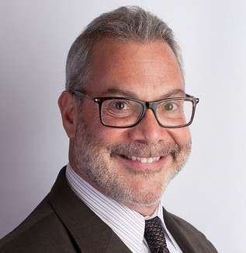
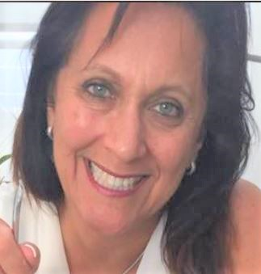
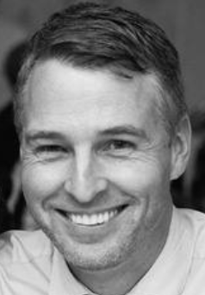
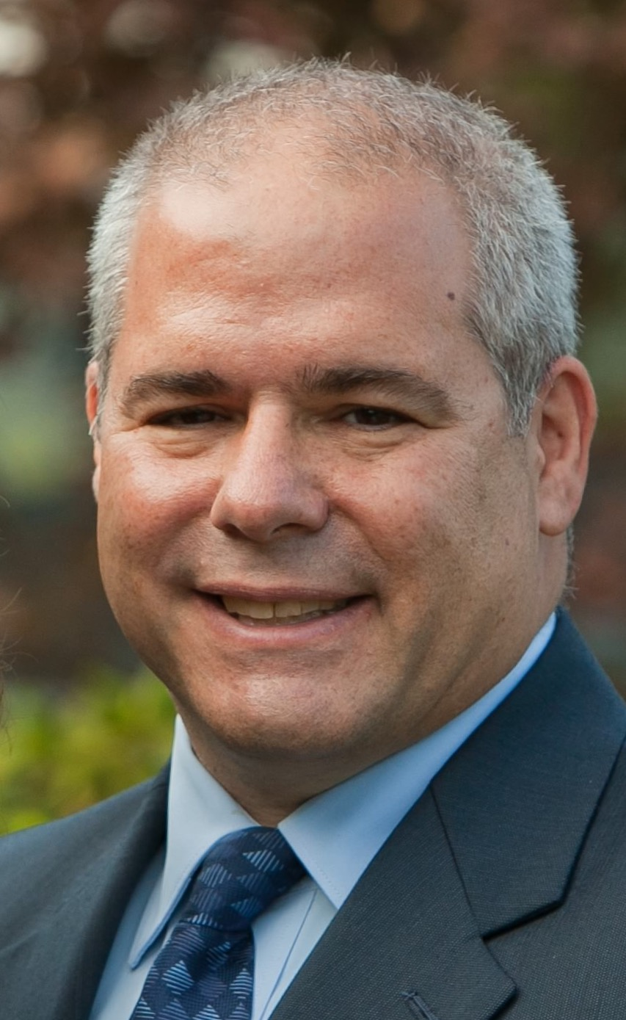
Gordon Loeb
Trusted advisor to business and law firm leaders
and President of Loeb Leadership
Natalie Loeb, MS
Talent Development Expert,
Executive Coach and
CEO of Loeb Leadership
David Robert, MBA
Chief Strategy Office
for Loeb Leadership
David B. Sarnoff Esq.
Executive coach and
leadership trainer with Loeb Leadership
A. Jonathan Trafimow, JD
Partner at Morritt, Hock & Hamroff LLP where he
Co-Chairs its Employment Law Practice Group
Notes:
Nat - Brief introductions and the lens in which we look at this topic.

Slide 2
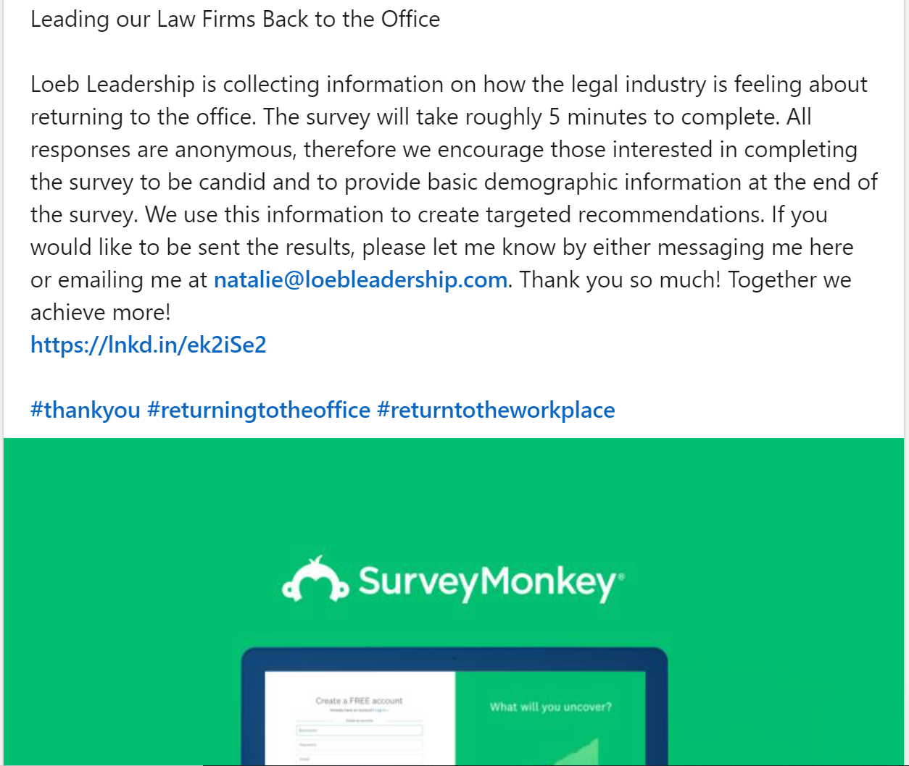
“The Return to the Office May Be a Tricky Transition for Law Firms”
Notes:
Nat open with:
Reminder of collaboration on survey with Loeb and ALA and the overall “message” we received.
Tee up David Robert for some of the take aways from the survey..

Slide 3
Back to the Office – Practical Considerations
Notes:
13-15 mins
DB take the lead here and summarize report and ask
DR questions on results…how will decisions impact culture
Let DR speak a bit…
Ask for John’s input on “commuting”. Getting to work is not employer’s problem
Highlight the “commuting” concern and ideas to poll employees on how they commute…
Mandating some work in office and can’t justify it = problems.
Tee up John for some of the legal questions
For example: What if all litigators have to come in but not the…..(other group)
Stop to ask group for questions.

Slide 4
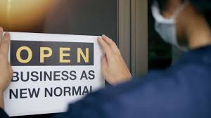
Returning to the Office – Legal Considerations
Notes:
Returning to the office – legal considerations
John can speak a bit about some of the top most legal concerns of clients. Then perhaps address the questions below:
These questions are from an ALA member
Will all levels of attorneys be allowed to work remotely or only after having been with the firm for period of time (i.e. 6 mos, 1 year, etc.)
Requiring employees who will be in the office to: a. Get the COVID vaccine (i.e. condition of employment) b. Show proof of vaccination
Seque to the importance of how the leader’s behavior as folks return to office to tee up Natalie and Gordon and DB for next section….
According to Almalw 2/24
Fish& Richardson, McGuireWoods, Stoel Rives and Shook, Hardy & Bacon have said they will likely not require proof of vaccinationas a condition to returning to their offices. Firms such as Proskauer Rose and Debevoise & Plimpton have yet to decide.
So far, Davis Wright Tremaine is the only Am Law firm that has publicly said it will mandate vaccination for attorneys who want to return to the office.
The trend tracks with a recent study by Gartner wich survey 236 hr legal, compliance and privacy leaders in Decembe 2020 and January 2021, and found that only 8% of respondents said they will require their employees to get a covid vaccine.
Roughly 71% of those surveyed said the would “encourage” but not mandate vaccination.

Slide 5
Returning to the Office – Leadership
Notes:
Gordon/Natalie and DB can address questions here:
Somebody asks:
How to inspire folks to come back? Connect Active Listening
When they come back what does a leader need to do?
i.e. make intentional effort to “touch bases” with our teams
Pay attention to individual needs; watch what people are saying and not saying
(Body language as well as words)
Model good wellness practices for your team.
DWYSYWD
Show up at the virtual “baby shower” to show you care. Make time for the little things
It’s ok to talk about Netflix binges at one on ones.
Have those one on ones
Active listening – free quiz on APA website
Defy the Verdict? (Gordon - offer some of the thoughts from Jim and Barry about navigating change?)

Slide 6
Email David Sarnoff at dsarnoff@loebleadership.com
Notes:
Remind folks that this summary is available

Slide 7
Gordon Loeb
Gordon@loebleadership.com
Natalie Loeb, MS
natalie@loebleadership.com
David Robert, MBA
David@loebleadership.com
David B. Sarnoff Esq.
dsarnoff@loebleadership.com
Jonathan Trafimow, JD
jtrafimow@moritthock.com
Notes:
Thank everyone and offer our contact information.
Highlight our remote programming?

