Slide 1
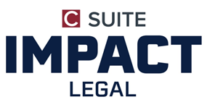


Slide 2
Tips for Managing Up
Administrative strategies to facilitate change and advantageously support
decision-makers and staff

Slide 3
Let’s talk about
Communicate Up
How to make a Business Case
Influences Up- leverage Peer Firms
Building Teams to Influence
Building Relationships- Building Teams
Stay knowledgeable to Focus up
Meeting Flow
Getting People to Buy In

Slide 4
Communicate Up
Tip for Speaking up
What’s going on at the firm
Strive for a positive attitude
Embrace humor
It’s nice to be important but more important to be nice!

Slide 5
How to Make a Business Case
Success Stories
Learn how to say it
Sometimes what you don’t say is key
Think about value and opportunity cost
  Value of a good administrator
  Make your point at least once- no matter how painful

Slide 6
Influences Up- Leverage Peer Firms
Financial Tip
Create A/R policy
Emphasize 90-day receipts
Give examples of improved receipts
Discuss slackers & company enforcement tactics

Slide 7
Building Teams to Influence
Info to Share
Share information
Share skills to improve productivity

Slide 8
Building Relationships-Building Teams
Implementation
Suggest skill sharing opportunities with other department heads
Ease discussions toward similar steps to advance group knowledge

Slide 9
Stay Knowledgeable to Focus Up
Implementation
Keep up to date on current events
Keep leadership informed of what you are doing

Slide 10
Meeting Flow
Ideas for Progress
Suggest meetings after hours/remote
Try to be one step ahead by listening and learning to manage your style to compliment your firm’s needs

Slide 11
Getting People to Buy In
Success Stories
Show that success is due to everyone’s participation
Plant seeds and watch things grow
When Managers “get it”, magic happens

Slide 12
Impact Legal Resources LLC
IMPACT Legal Resources (ILR) was formed to help Law Firms and the people that work in law firms with Growth, Performance and Succession.
The ILR team has hands-on experience with all areas of legal practice management. From Human Resources, Technology, Finance, Facilities as well as Marketing and Business development. Whether your finance department has needs for additional hands to help with specific projects, whether you need a new associate or lateral partner with a book of business, ILR can help.
Services include:
Talent Acquisition at all levels and all roles within your law firm,
M&A, Training and Coaching,
Partner Retreats,
Practice Management Consulting and outsourced back-office services.
The ILR team provides a guarantee that takes the risk out of the equation. Simply put if you are not satisfied with our services…don’t pay our invoice! We are here to help!
With IMPACT GPS, we help our clients in three core areas: Growth, Performance and Succsess.ion.
Check out our IMPACT GPS today!
https://impactlegalresources.com/

Slide 13
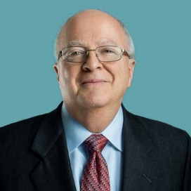
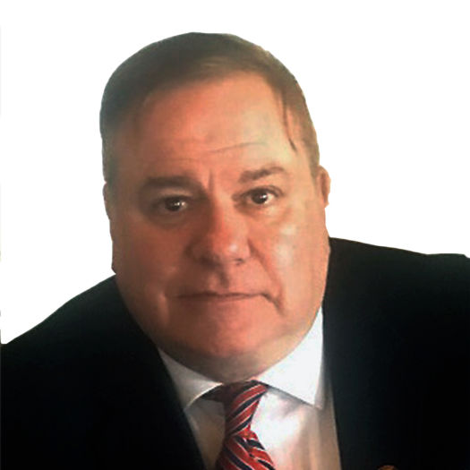
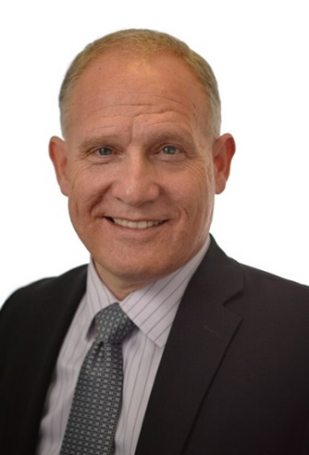
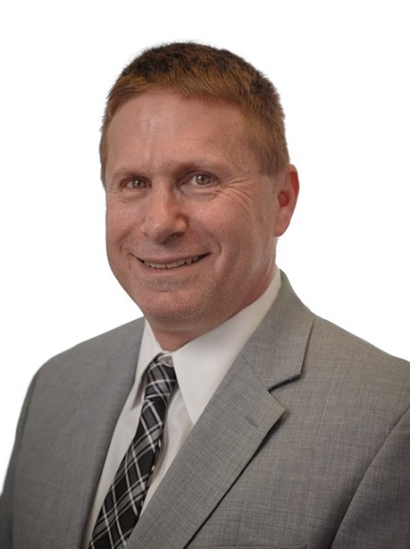
TEAM
Barry Jackson, MBA, CLM
Chief Executive Officer & President
Barry has facilitated the practice of law as head of non-legal operations in the Law Firm arena for over 21 years and has over 30 years of law firm experience. He was the President of the Association of Legal Administrators NYC in 2006 and also served 5 years on the NYSBA Legal Practices Committee. The NYSBA asked Barry to be a principal of
Best Practices in Legal Management:
A Comprehensive Guide,
which was published in 2010 and sold nationwide, becoming a best seller.
Henry has more than 25 years of law firm administrative management experience at large, mid-sized, and small law firms. He is the former Controller for Philips Nizer and was an active ALANYC member having served as a Regional Director, President of the ALANYC, and as a National At-Large Director. Henry has presented at ALA local and regional venues and at the NYC Bar Association.
Phil Whitman
Managing Member
Firms of all sizes from sole practitioners to top 10 global firms rely on him. Phil specializes in succession planning, mergers & acquisitions, strategic talent acquisition and practice management consulting. With firm management experience ranging from three partners, twelve employees, and $2 million in annual revenues to one of the Top 30 CPA firms in the Nation, with 48 partners, 400 employees and almost $100 million in annual revenues, there’s nothing Phil hasn’t seen.
David is an entrepreneur and has been a guide for entrepreneurs throughout his adult life. He is the author of The Micro Niche Method: The Pathway to Premium Pricing and Increased Profitability. The Micro Niche Method is a process that brings Business development success to professional services firms. David has received several business awards, including ARC Employer of the Year and Fortune Small Business Magazine Boss of the Year finalist.

Slide 14





Slide 15




Impact Legal Resources LLC
https://impactlegalresources.com/
Growth
We hope we have you thinking about ways to make your life easier while improving your firm and your relationships with your top executive team, your manager, or assistant.
It starts with you!
If you find you need temporary or permanent solutions, call one of us. We are ready to provide one-on-one ideas tailored to your situation.
Performance
Succession

Slide 16
CONTACT INFORMATION
Barry Jackson
Email bjackson@impactlegalresources.com
Henry Macchiaroli
Email hmacchiaroli@impactlegalresources.com
David Wolfskehl
Email
dwolfskehl@impactlegalresources.com
Phil Whitman
Email pwhitman@impactlegalresources.com
Thank You!

