Slide 1
Vestian | Case Study Example
October 2020

Slide 2
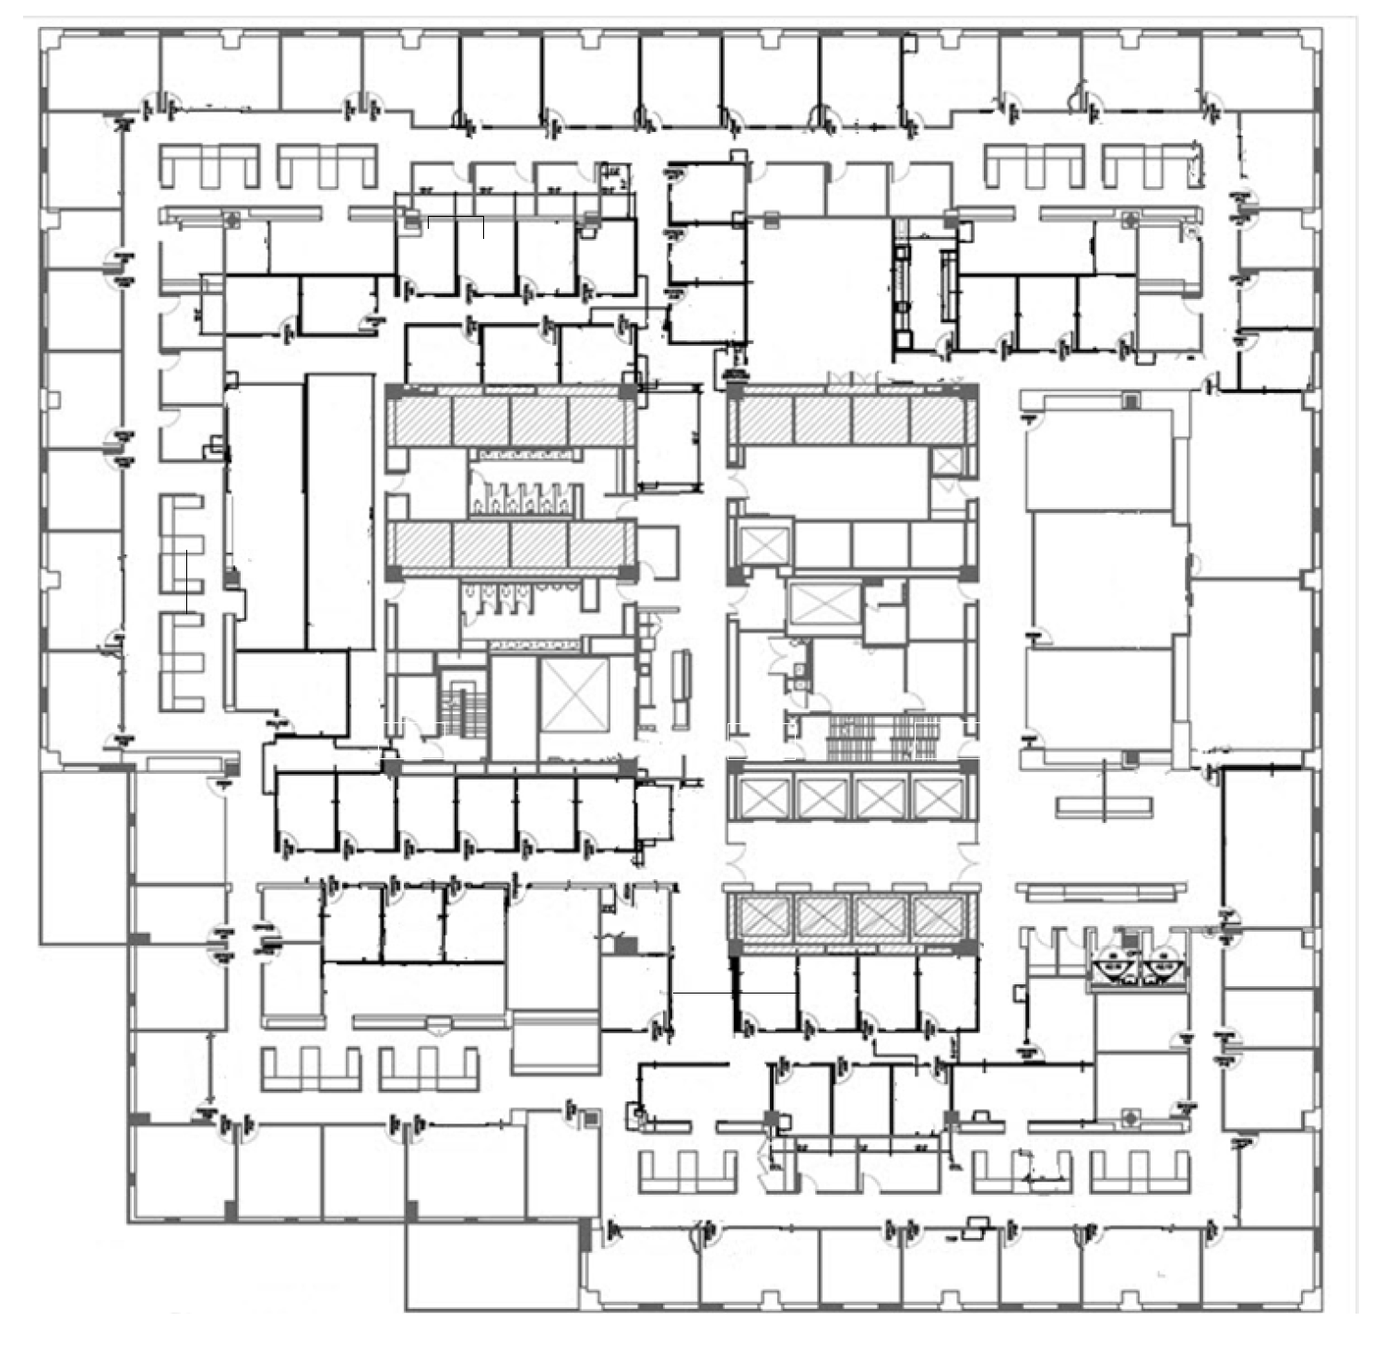
A NEW PLAN FOR REAL ESTATE
Current Occupancy (Old Way)
Traditional Class A office Prime Tier 1 Market
55,000 RSF – 78 total staff/attorney
1,057 RSF/attorney - $3.5M per annum spend
12/31/23 LX - $10.5M total spend remaining
$67,000 cost per attorney per annum
Dedicated office for all attorney’s & staff
100% of all attorneys and staff come in every day
Partner and associate offices varying sizes
Heavy conferencing
*Analysis for all solutions starts 1/1/20

Slide 3
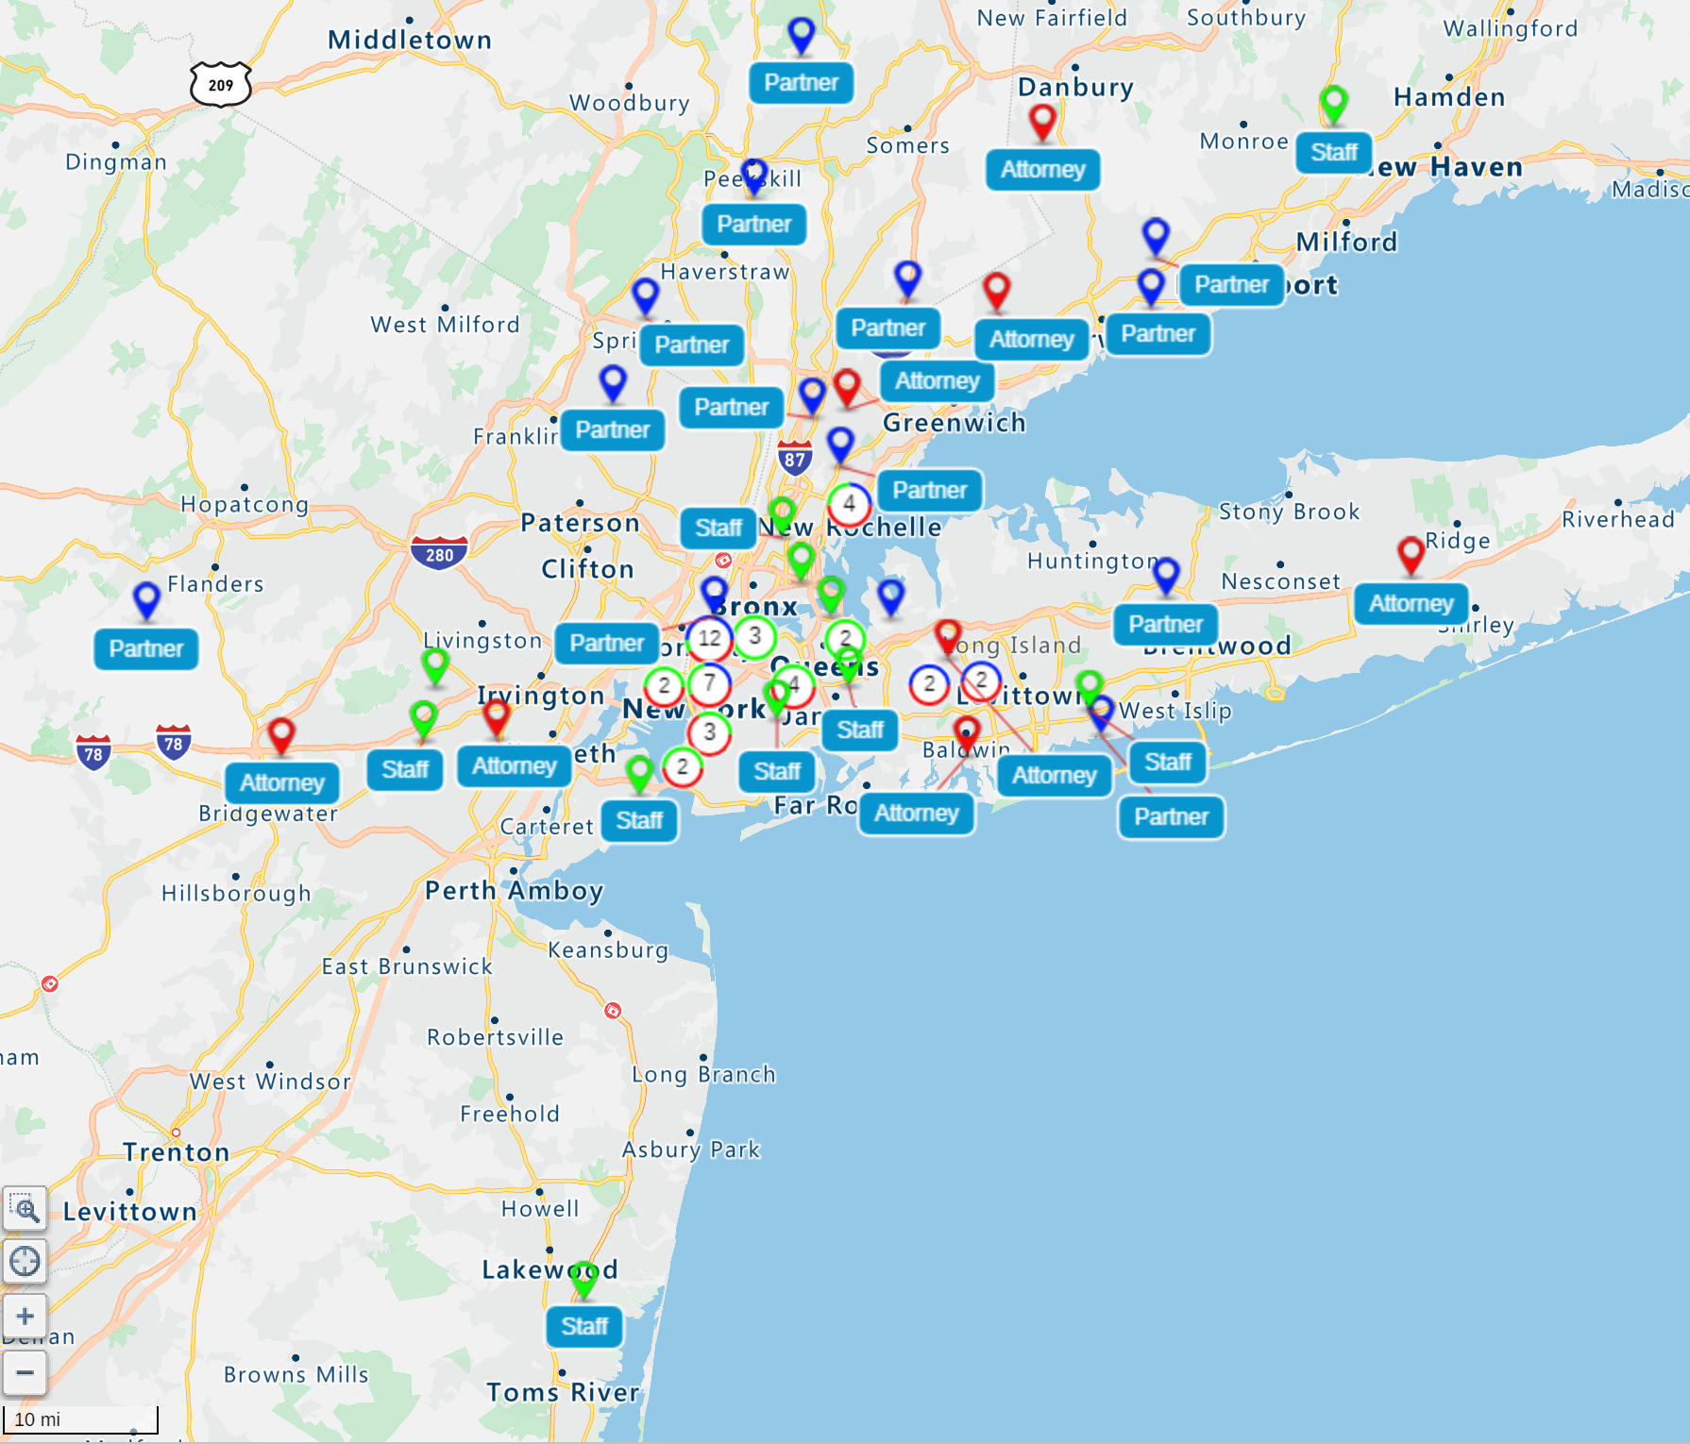
A NEW PLAN FOR REAL ESTATE
Current Geographic Allocation
Residence | Office | Attorney | Partner | Staff | Total
NYC | NYC | 14 | 10 | 21 | 45
Long Island | NYC | 4 | 5 | 1 | 10
New Jersey | NYC | 3 | 4 | 3 | 10
CT/Westchester | NYC | 5 | 7 | 1 | 13
Total | N/A | 26 | 26 | 26 | 78
Density/RSF | N/A | 2,115 | 2,115 | 1,057 | 705
50% of office with one-way commute of over 45 minutes
More than 40% of employees live outside NYC
54% of all attorney’s/partners live outside NYC
80% of all staff live in NYC
Clusters of employees in Long Island, New Jersey, CT/Westchester
$4M potential billable revenue opportunity by reducing commute time

Slide 4
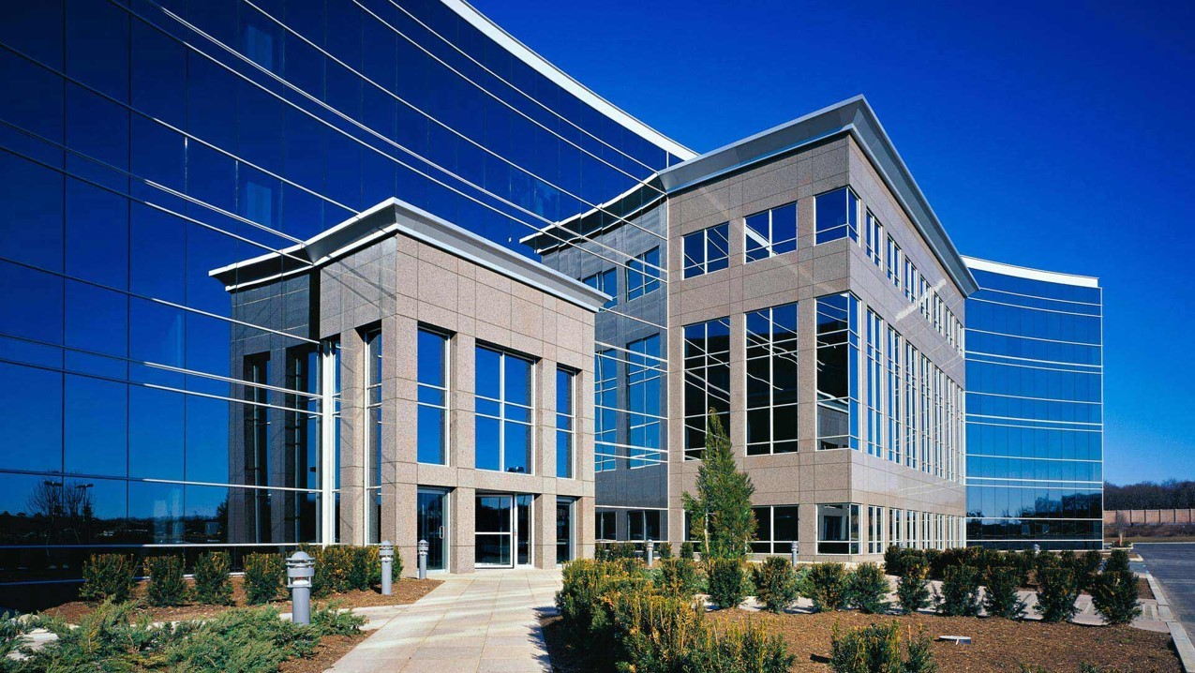
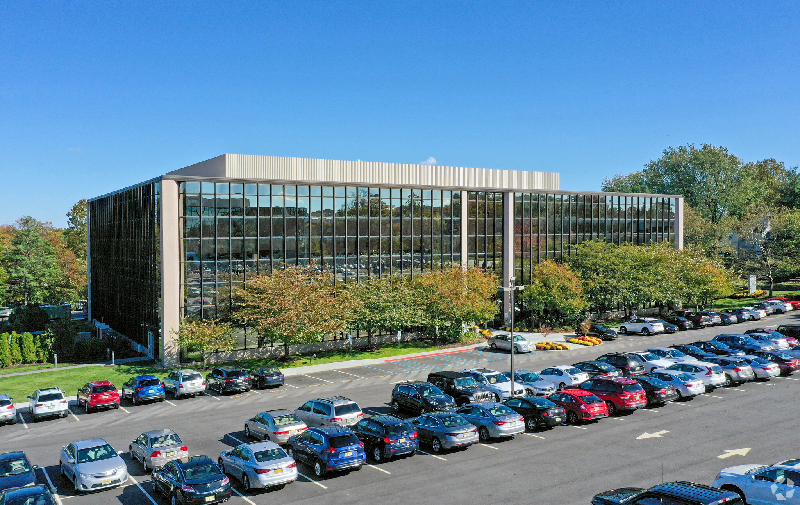
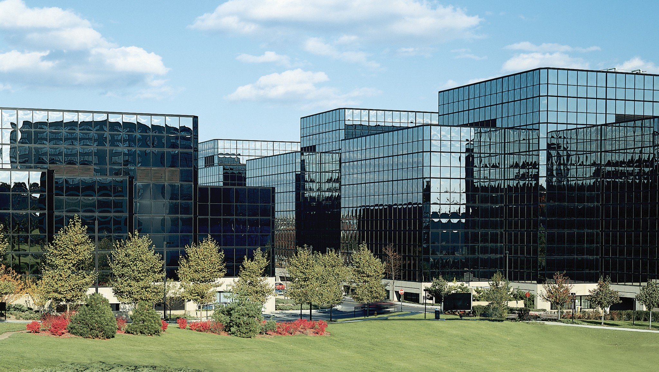
A NEW PLAN FOR REAL ESTATE
Reimagined Occupancy (New Way)
HUB 19.100 RSF: Maintain Traditional Class A office Prime Tier 1 with 65% RSF reduction
Spoke 2,500 RSF: Backfill in existing 50% utilized Greenwich, CT location; secure new offices in New Jersey and Long Island clusters
*Analysis for all solutions starts 1/1/20

Slide 5
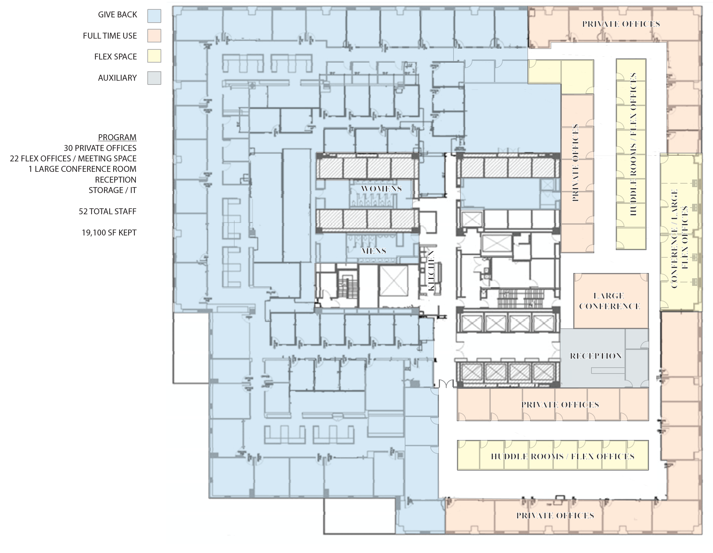
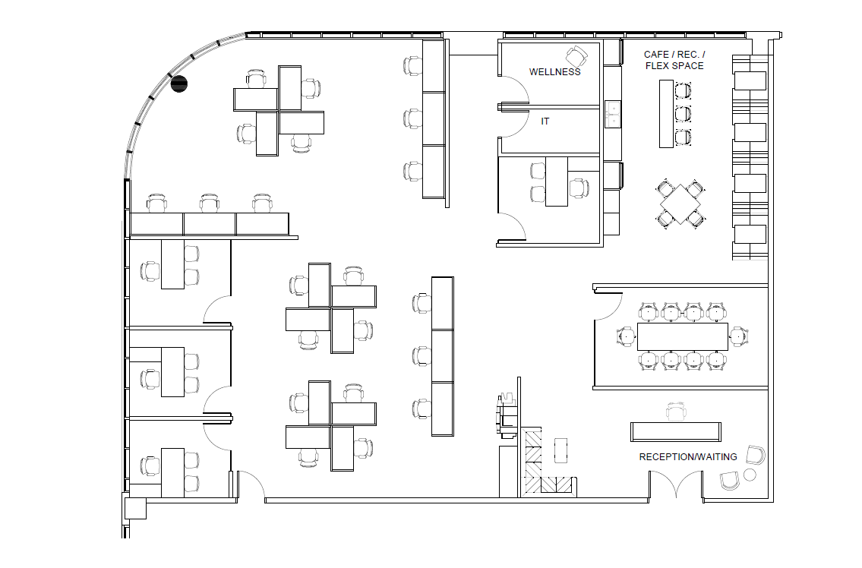
A NEW PLAN FOR REAL ESTATE
Reimagined Occupancy (New Way)
Hub
33% of employees come in every day
33% 1-2 days a week
33% full time remote
Hub can accommodate 52 at full occupancy
Ideal daily full occupancy is 35-40 to leave huddle rooms and conference rooms open for 3-4 person zoom meetings
Dedicated offices/seats for fulltime occupants
Huddle rooms / smaller meetings rooms
Maintain current office size
Spoke assumes 33-50% daily occupancy
Spoke
*Analysis for all solutions starts 1/1/20

Slide 6
A NEW PLAN FOR REAL ESTATE
Financial Impact & Output (New Way)
Solutions | RSF | LX | Total Partners, Attorneys & Staff | Total Partners & Attorneys | RSF/Attorney | Annual Cost | Total Cost Through 12/31/23 | Total Savings Thru 12/31/23 | Total Cost Through 12/31/30
1. Status Quo / Current | 55,000 | 12/31/23 | 78 | 52 | 1,057 | $3.5M | $10.5M | $0 | N/A
2. Hub & Spoke Now Downsize and Restructure NYC Lease 19,100 RSF (Hub), Open 2,500 RSF Long Island and NJ office, back fill in CT office | 24,100 | NY -12/31/30 LI – 12/31/30 NJ – 12/31/30 | 78 | 52 | 463 | $1.4M | $4.0M | $6.5M | $14.5M
3. Hub & Spoke at LX Implement Hub & Spoke strategy at lease expiration | 24,100 | NY – 12/31/30 LI – 12/31/30 NJ – 12/31/30 | 78 | 52 | 463 | $2.1M | $10.5M | $0 | $21.4M
Reimagined workplace merged with hub and spoke, and lease restructure can reduce remaining recurring rent spend by $6.5M
Will not have an opportunity to get back $6.5M if wait to implement – each month valued at $180,000 in savings
Requires change management and buy in from attorney’s/staff – must view reimagined workplace as recruiting and retention tool
Will new first years be viewed as full time in office employees – training planning and accountability critical
Lease flexibility (expansion, termination options) and tenant improvement allowance mandatory – may require FF&E investment
Consider alternative exit strategies if landlord proves difficult (amortization, lease buyout, withholding of rent)
*Analysis for all solutions starts 1/1/20

Slide 7
CONTACT INFO
Gregg Espach
Executive Managing Director
espach@vestian.com
T: 203.913.6214
Joe Mclaughlin
Managing Director
mclaughlin@vestian.com
T: 212.239.8400
Francine Niemiec
President - Account Services
niemiec@vestian.com
T: 312.880.4020
Jeremy Done
Managing Director
done@vestian.com
T: 214.394.8840

