Slide 1
401(k) News and Best Practices
Key Considerations for Employers to Address
FOR PLAN SPONSOR USE ONLY. Pensionmark® Financial Group, LLC (“Pensionmark”) is an investment adviser registered under the Investment Advisers Act of 1940. Pensionmark is affiliated through common ownership with Pensionmark Securities, LLC (member SIPC).

Slide 2
Retirement Plan Specialists
A boutique experience with the strength and resources of a national firm.
3,350
Retirement Plan Clients As of 6/1/2020
$48B
Assets Supported¹ $19B in Regulatory Assets under Management.¹
With Assured Partners you get the best of both worlds, working with an experienced independent advisor backed by a network of support specialists.
310
Team Members As of 6/1/2020
60
Locations As of 6/11/2020
As of 12/31/19 the Pensionmark network of advisors and firms collectively provides support to over $48 billion in assets across a variety of channels including investment management and retirement plan consulting services. This includes regulatory assets under management (AUM) of over $19 billion.

Slide 3
Reflecting on the Crisis
How were you impacted?
Where did you adapt?
Who did you rely on for counsel?
What lessons were learned?
What are your key priorities for moving forward?

Slide 4
The SECURE Act
THE SECURE ACT PASSES IN THE SENATE
On December 19, 2019 congress passed the SECURE (Setting Every Community Up for Retirement Enhancement) Act.
The bill removes certain barriers to entry for small businesses and should increase accessibility across employers, encourage employees to contribute, keep them invested, and provide them with retirement income options.
KEY TAKEAWAYS
Open Multiple Employer Plans (MEPs): Small plans will now be able to pool plans with two or more unaffiliated companies to receive similar benefits as larger plans, typically, lower recordkeeping fees, greater investment flexibility and better administrative support.
Safe Harbor for Annuities: Sponsors receive safe harbor protection to include annuities in their investment offerings and protects the employer from litigation if the annuity provider were to go out of business or defraud plan participants.
Lifetime Income Disclosures: This requires participants to receive an estimate of their projected monthly income in retirement, given their current account balance and other assumptions.
Tax credit for new plans: Employers starting a new retirement plan will be able to use a $5,000 tax credit (an increase from $500). Those who implement an auto enrollment feature in their plan design will be eligible for an additional $500 credit per year for up to three years.
Access for long-term part-time workers: Part-time workers who work at least 500 hours for three consecutive years (12-month periods) will be allowed to make deferral contributions. However, this group of employees may still be excluded from employer contributions.
Distributions: The bill raises the age for Required Minimum Distributions from 70 ½ to 72 and allows for penalty-free withdrawal for individuals of any age within a year of a child’s birth or adoption.
Most of the provisions in the SECURE Act are effective January 1, 2020, while others, such as provisions regarding open MEPs, in-plan annuity features and access for long-term part-time workers, will have longer implementation timelines. Plan sponsors should consult with their retirement plan advisors or ERISA attorneys to make sure their plans are in compliance with the new provisions.
Additional Resources: Legislative Bulletin – The SECURE Act, SECURE Act Fact Sheet

Slide 5
Saver’s Credit - 2020
The tax saver’s credit is available for some employees who make Individual Retirement Account (IRA) contributions or salary deferral contributions to 401(k) plans. The amount of tax saver’s credit is a percentage of your contribution with a maximum of $4,000 if filing jointly. The percentage is based on your adjusted gross income and phases out as your income increases. The tax saver’s credit for 2020 is shown in this chart:
Joint Filers | Heads of Households | Single, Married, Filing Separate, Qualifying Widow(er) | Credit Rate | Maximum Credit
$0 - $39,000 | $0-$29,250 | $0 - $19,500 | 50% | $2000
$39,001 - $42,500 | $29,250 - $31,875 | $19,501 - $21,250 | 20% | $800
$41,501 - $65,000 | $31,876 - $48,750 | $21,251 - $32,500 | 10% | $400
$65,000+ | $48,750+ | $32,500+ | 0% | $0
In addition to the income limitations, eligibility requirements for the tax saver’s credit include:
Must be 18 years of age or older
Cannot have been a full-time student during the calendar year
Cannot be claimed as a dependent on another person's tax return
How the tax saver’s credit may help you
As you may know, when you defer a portion of your pay into the plan, you reduce the amount of your income subject to federal taxation. With the tax saver’s credit, you may be reducing your taxes even further.
*Chart Source: www.irs.gov

Slide 6
CARES Act and COVID-19 Relief Package
CORONAVIRUS, AID, RELIEF, AND ECONOMIC SECURITY (CARES) ACT
On March 27, 2020, the U.S. House of Representatives passed the “CARES Act” that was passed in the U.S. Senate on March 25, 2020.
The federal stimulus package is the largest relief bill in American history, estimated to cost over $2 trillion. The massive bipartisan bill is broad in scope, as it hopes to offer financial assistance to distressed sectors, individuals, hospitals, and businesses impacted by COVID-19.
CORONAVIRUS RELATED DISTRIBUTION (CRD)
The Coronavirus Relief Package has come in 3 separate bills - each aimed at offsetting the impact the global pandemic has had, and will continue to have, on the U.S. economy, healthcare system, and American workers.
Coronavirus Preparedness and Response Supplement Appropriation Act, 2020 (Signed into law 3/6/2020)
Families First Coronavirus Response Act (Signed into law 3/6/2020)
Coronavirus, Aid, Relief, and Economic Security (CARES) Act (Signed into law 3/6/2020)
The 10% early withdrawal penalty is waived for an individual who takes a distribution on or after 1/1/2020 and before 12/31/2020 if they: 1) are diagnosed with COVID-19, 2) have a spouse or dependent diagnosed with COVID-19, 3) individually experience or have a spouse who experiences adverse financial consequences as a result of being quarantined, laid off, furloughed, 4) meets other factors as determined by the Treasury Secretary. The individual would owe ordinary income taxes on the withdrawal, but the new legislation allows for those taxes to be paid over a 3-year period. In addition, the individual can avoid taxes on the withdrawal entirely if they redeposit the funds back into their account within three years. This is handled through a self-certification process.
LOANS
The following plan loans are available to participants who meet the above requirements regarding CRDs: For plan loans taken 3/27/20 – 9/23/20, maximum loan amount is doubled to lesser of $100,000 or 100% of the vested account balance for loans to qualified participants; participants who have a loan from their account that is due 3/27/20-12/31/20, can delay their repayment(s) and extend the term of the loan for up to 1 year; changes can be adopted immediately provided the plan is amended on or before the last day of the first plan year beginning on or after 1/1/2022 (or later if prescribed by the Treasury Secretary).
REQUIRED MINIMUM DISTRIBUTIONS (RMDs)
RMDs from defined contribution plans described in 401(k), 403(a) and 403(b), eligible (governmental) 457(b) plans, and IRAs are waived for calendar year 2020. This includes the RMDs for participants that turned 70½ during 2019 and had not taken their distribution prior to January 1, 2020.
COVID-19 Employer Resources, CARES Act-FAQ
Neither Pensionmark Financial Group nor its advisors provide tax or legal advice. Please consultant with an outside professional regarding your particular set of circumstances.

Slide 7
IRS & DOL CARES Act Guidance & Clarifications
IRS
DOL
NOTICE 2020-50 & 2020-51
EBSA DISASTER RELIEF NOTICE 2020-01
Expands CRD and Loan qualifications to individuals who 1) experience reduction in pay or have a job offer rescinded or start date delayed due to COVID-19 2) have a spouse or person sharing an individual’s principal residence experiencing an of the qualifying requirements.
Amends self-certification rules to include Loans.
Clarifies the responsibility of the plan sponsor as it relates to CRDs, Loans, and RMDs.
Permits rollovers of waived RMDs and certain related payments, including an extension of the 60-day rollover period for certain distributions through August 31, 2020;
Provides a sample plan amendment that, if adopted, would provide participants a choice whether to receive waived RMDs and certain related payments.
Extended filing relief for Form 5500 and Form M-1 until July 15, 2020.
Extended deadline to provide certain notices and disclosures which are due on or after 3/1/20, until 60 days after the announced end of the COVID-19 National Emergency.
Allows blackout notices to be provided less than 30 days before the beginning of the blackout period.
Waived enforcement action with respect to temporary delay in remitting participant contributions and plan loan repayments due on or after 3/1/20 through 60 days after the announced end of the COVID-19 National Emergency.
Allows for corrective actions for failure to follow the terms of the plan regarding loans and distributions in certain circumstances under areas of DOL jurisdiction.
Although both the IRS and DOL have provided additional relief, we recommend plan sponsors continue to require appropriate documentation and compliance in advance of any loan or distribution and maintain a consistent schedule when administratively feasible regardless of extensions.
IRS Notices 2020-50 and 2020-51
DOL EBSA Notice 2020-01

Slide 8
DOL ISSUES FINAL REGULATION ON E-DELIVERY OF PLAN DISCLOSURES
The DOL now permits electronic delivery as a default of retirement plan participant disclosures required by Title 1 of ERISA, aiming to make notices more accessible to employees, reduce the administrative burden for the employers, create efficiencies by leveraging technology, and potentially reduce plan costs. Electronic delivery includes website posting and/or email delivery.
WHAT IS REQUIRED BY PLAN ADMINISTRATORS?
WHAT IS INCLUDED IN TITLE 1?
Initial notification by paper to all participants including:
Information about new electronic delivery method,
The participant’s email address on file that will be utilized for electronic delivery,
Option to opt-out of electronic delivery, and
Information about how to opt-out at any time, free of charge.
SUMMARY PLAN DESCRIPTION (SPD)
SUMMARY OF MATERIAL MODIFICATION (SMM)
SUMARY ANNUAL REPORT (SAR)
ANNUAL FUNDING NOTICE
404(a)(5)/404(c) DISCLOSURE
ANNUAL QUALIFIED DEFAULT INVESTMENT ALTERNATIVE (QDIA) NOTICE
BLACKOUT NOTICE
PENSIONS BENEFIT STATEMENT
Annual Notification of Internet Availability (NOIA) describing all notices available on the website with the option to opt-out of electronic delivery.
Website retention of all electronic documents until there is a subsequent version, and for no less than a year.
Upkeep of electronic addresses on file for active and terminated participants.
DOL Issues Final Regulation on E-Delivery of Plan Disclosures

Slide 9
PEP
MEP
Pooled Employer Plan
Multiple Employer plan
Allows unrelated Employers meeting specific requirements (for example a bundled recordkeeper or third-party administrator) to unite and participate in a single retirement plan.
Allows Employers to take advantage of a collective purchasing power in efforts to obtain lower fees and enhanced services.
PEPs are limited to 401(k) plans only.
Defined Benefit plans, 403(b) plans, 457(b)/governmental plans and MEPs are excluded in PEP provisions.
Allows related Employers (for example, within the same industry) to unite and participate in a single retirement plan.
MEPs existed prior to the SECURE Act.
Prior to the SECURE Act, one Employer within the MEP could disqualify the entire plan should they not oblige with compliance regulations. This provision has since been eliminated with the SECURE Act.
A MEP can be a 401(k) plan, Defined Benefit plan, 403(b) plans, 457(b)/governmental plans.
Resource: SHRM Resources

Slide 10
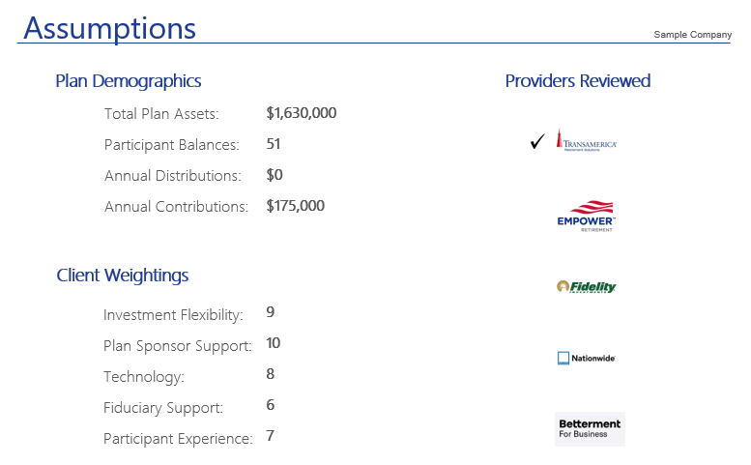
Market Study

Slide 11
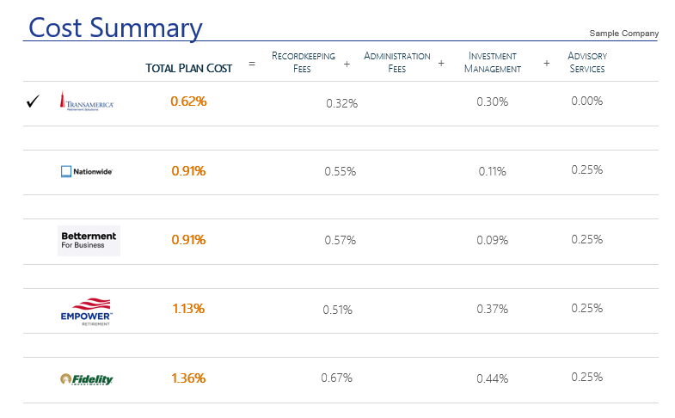
Market Study

Slide 12
Monitor/Benchmark Investments

Slide 13
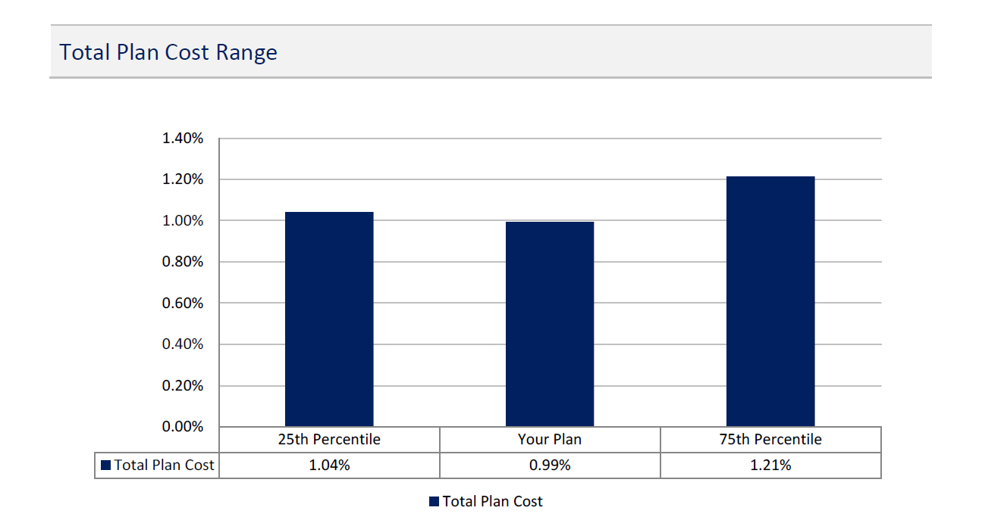
Fee Analysis

Slide 14
What plan risks or exposures need to be addressed?
Fiduciary Advocate
Impacts from managing cash flow
Employee Financial Anxiety and Vulnerability
Investment Exposures
Provider Blind Spots
Unprotected Data
Increased Regulatory Complexity
Retirement Recovery Plan

Slide 15
Impacts from managing business cash flow
Understanding the impacts:
Employee furloughs and terminations
Reducing or eliminating 401(k) employer contributions
Changes in HR staff administering the retirement program

Slide 16
Increased Regulatory Complexity
New burdens to address
CARES Act
SECURE Act
Electronic Disclosure

Slide 17
Increased Regulatory Complexity
Audit Concerns
Timely Contributions
Eligibility Requirements
Definition of Compensation
Loans and Distributions

Slide 18
Avoid pitfalls from unprotected data
Assess your cybersecurity risks
Educate employees on handling sensitive data
Review provider cybersecurity protocols
Review insurance coverage
Encourage participants to protect 401(k) accounts
Source: Javelin 2020 Identity Fraud Study: Genesis of the Identity Fraud Crisis

Slide 19
Investment Exposures
Review plan investments
Review your process and documentation
Ensure you are using the lowest cost share classes
Assess appropriateness of Target Date Fund glidepath
Provide education on market volatility
Consider guaranteed income solutions

Slide 20
Avoid Provider Blind Spots
Stress test relationships
Minimum Requirements
&
Best Practices

Slide 21
Stress Test Recordkeeper
 | Minimum Requirement | Best Practices
Retains compliant, streamlined and accurate processing | √ | √
Provides full administrative services – notices, testing, 5500 filing, statements | √ | √
Consistent support requirements | √ | √
Reasonable fees | √ | √
Full Integration with payroll provider |  | √
Personalized digital experience – online, mobile and human touch points |  | √
Robust wellness and retirement tools |  | √
Cybersecurity protection |  | √
Proactive assistance with legislative changes |  | √
Crisis Management Plan – Formalized and Tested |  | √

Slide 22
Stress Test Advisor
 | Minimum Requirement | Best Practices
Plan Fiduciary – 3(21) or 3(38) | √ | √
Transparent, Fee-based service model | √ | √
Educate committee | √ | √
Rigorous and objective investment process | √ | √
Specialist |  | √
Comprehensive service model that covers all the bases |  | √
Participant financial coaching and wellness platform |  | √
Crisis Management Plan – Formalized and Tested |  | √

Slide 23
Employee Financial Anxiety and Vulnerability
67%
of US workers are significantly burdened by financial stress and it affects their work productivity
% of Employees interested in benefit
% of Employers offering benefit
Source: MassMutual Workplace Benefits Study 2018.

Slide 24
What Employees Need
Rebuild Finances
Holistic Assessment
Liquidity Needs
Short Term Planning
Long Term Objectives
Defined Action Plan

Slide 25
Rebuilding finances starts with emergency savings
Other Financial Goals
Retirement Savings to get 100% On-Track
Debt Management
Retirement Savings to Get Full Company Match
Emergency Savings to cover 3+ Months of Expenses

Slide 26
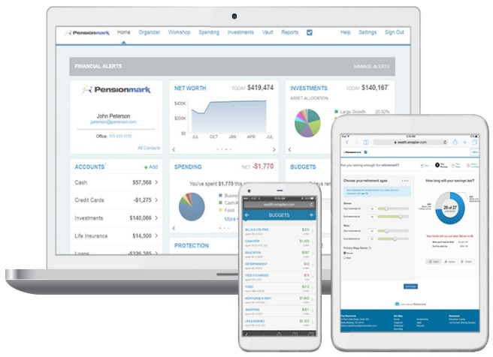
Comprehensive Model for Financial Wellness
Self Learning | Personalized Support | Tools for Action
Online financial education center Articles Videos Market recaps Financial calculators | Bilingual Financial wellness call center Live webinars Employee education meetings Individual consultations Group seminars | Our Personal Financial Portal Aggregates financial accounts for a full financial picture Calculates retirement gap analysis Tracks spending & budgets Provides solutions to make actionable results Employs advanced security features and encryption

Slide 27
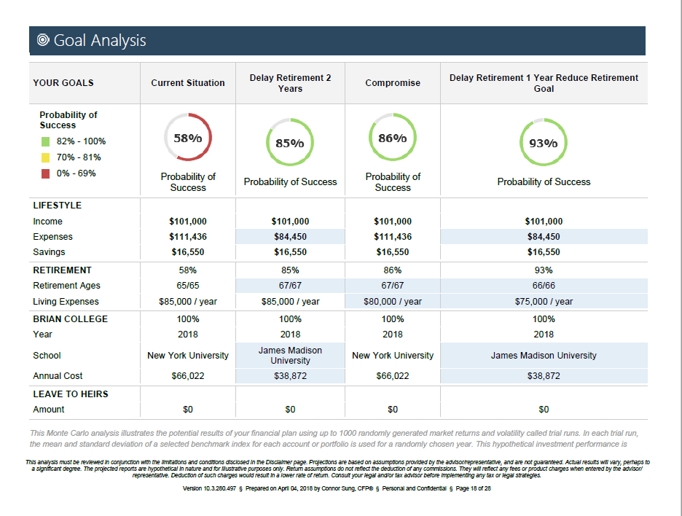
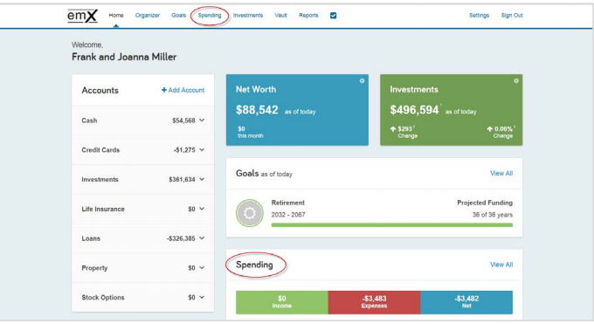
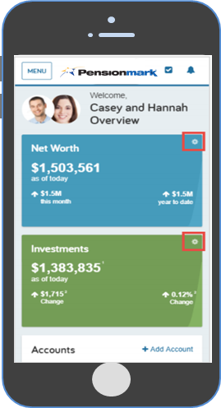
Employee Advice & Planning
Financial Advice & Planning Services through SMARTMap
Financial Advocates may assist employees with:
Goal Setting
Asset Allocation
Budgeting/Spending
Future Income Planning
Asset Protection
Disability Protection

Slide 28
How We Can Help
Conduct a diagnostic assessment that provides critical plan insight
Helps the committee create a unified vision and roadmap for decision making
Uses analytical insights to drive better retirement outcomes
Identifies potential fiduciary blind spots and exposures
Attain maximum leverage from partner resources
A comprehensive review of participant outcomes, investment process and plan administration
We can equip employers with more informed decision making to improve overall plan performance

Slide 31
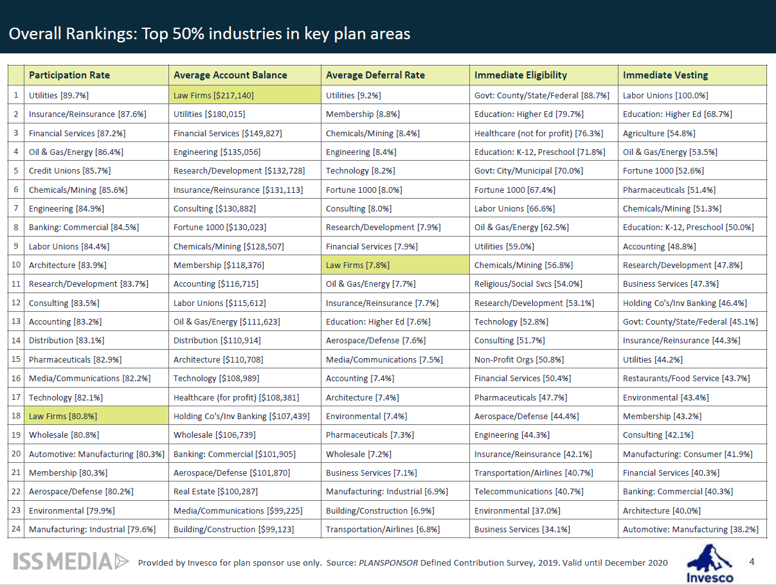

Slide 33
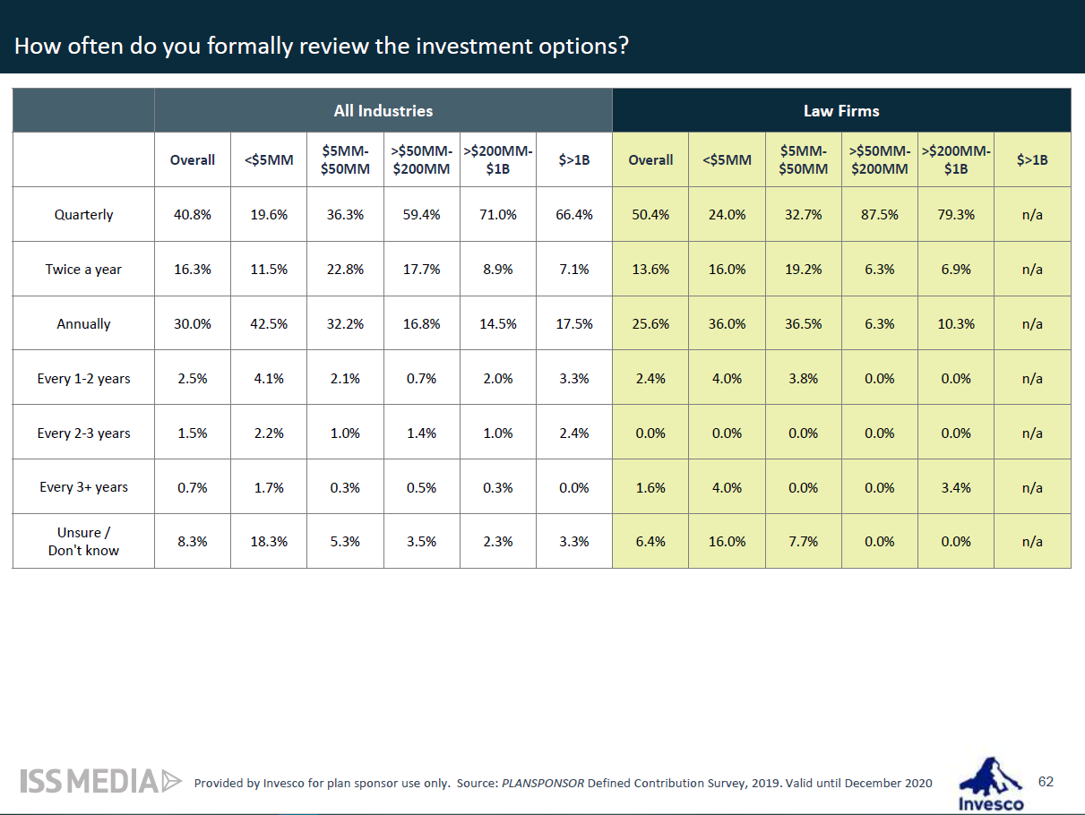

Slide 34
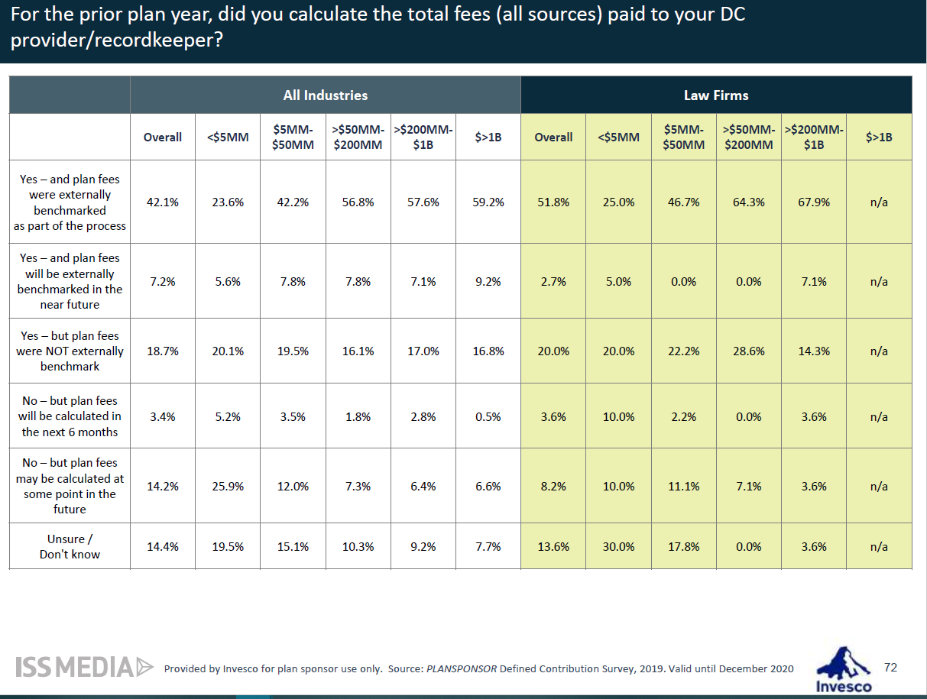

Slide 35
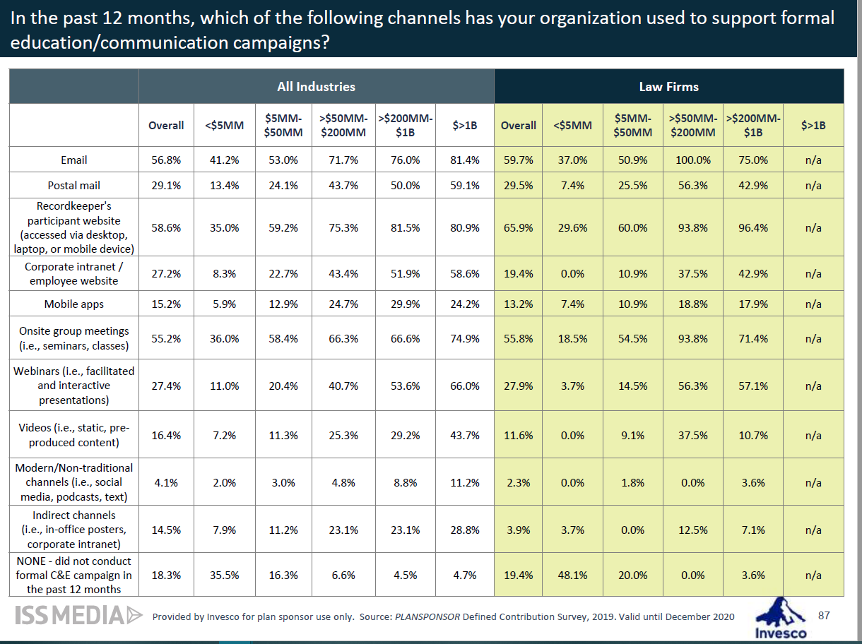

Slide 36
Questions?
FOR PLAN SPONSOR USE ONLY. Pensionmark® Financial Group, LLC (“Pensionmark”) is an investment adviser registered under the Investment Advisers Act of 1940. Pensionmark is affiliated through common ownership with Pensionmark Securities, LLC (member SIPC).

