Slide 1


Vestian | A New Plan for Real Estate
October 2020

Slide 2




Welcome & Introductions
GREGG
Espach
JOE
McLaughlin
FRANCINE
Niemiec
JEREMY
Done

Slide 3




What We’ve Found More Time for During the Pandemic
GREGG
Espach
JOE
McLaughlin
FRANCINE
Niemiec
JEREMY
Done

Slide 4
Pop Quiz

Slide 5
A NEW PLAN FOR REAL ESTATE
THE OPPORTUNITY
The best opportunity that law firms have seen in the last 30 years
NOW is the time to
Shed Costs
Improve Employee Satisfaction
Increase Productivity

Slide 6



MARKET DRIVEN
A NEW PLAN FOR REAL ESTATE
THE OLD WAY
10+
Long Term
Commitments
Real Estate Centric
Take-It-Or-Lose-It
Market Cost
Comparisons
BROKERS FOCUSED ON FINDING SPACE
10-15 YEAR DEALS WERE THE NORM
PRESSURE FOR TOO MUCH SPACE TOO SOON
LANDLORD MARKET RATES BECOME SELF-FULFILLING OPTIONS
650 RSF per Attorney | 150 – 250 RSF per Employee

Slide 7



A NEW PLAN FOR REAL ESTATE
THE NEW WAY
HOLISTIC APPROACH
Tenant-Focused
Focus on
Flexible Lease
Strategies
Understanding of
Total Occupancy
Costs
AGILITY TO EXPAND, CONTRACT, or EXIT
COST CONTROLS FOR VARIABLE EXPENSES
TECHNOLOGY AND FF&E DRIVING WORKPLACE CULTURE & PRODUCTIVITY
REDUCED SPACE KPIs: 300 - 500 SF per ATTORNEY | 75 SF per EMPLOYEE

Slide 8
SHED COSTS
Exit Strategy, Lease Buyouts, Give-Backs and Planned Footprint Reductions
Rent Reductions
Copiers, Office Supplies, Shredding, Coffee and Amenity Costs

Slide 9
IMPROVE EMPLOYEE SATISFACTION
Reduced Commute Times = More Billable Hours
Balance Personal & Professional Commitments
Minimize Exposure = Reduced Risk
Personal Cost Benefit of Remote Working

Slide 10
INCREASE PRODUCTIVITY
Recruiting Opportunities Less Dependent on Geography
Repurpose Physical Office Needs for In-Person Collaboration vs. Individual Workspace
Technology Driving Operational Efficiencies

Slide 11
Pop Quiz #2

Slide 12
A NEW PLAN FOR REAL ESTATE
CASE STUDY EXAMPLE
SEE CASE STUDY EXAMPLE

Slide 13
PROCESS
A NEW PLAN FOR REAL ESTATE
EXPERT EXECUTION
REAL ESTATE STRATEGY
STEADY STATE NEEDS

Slide 14
ASSESSING STEADY STATE
NEEDS
A NEW PLAN FOR REAL ESTATE

Slide 15



DEVELOPING A REAL ESTATE
STRATEGY
A NEW PLAN FOR REAL ESTATE
Opportunity is Everywhere
Determine underutilized, long remaining term
Understand business impact from remote work
Blend don't always extend
Align minimal square footage needs
Implement sensitivity analysis
Create new workspace
Leverage value of tenancy
Secure expansion options
Reduce total occupancy costs
Assess possibly going dark
Determine if short-term capital expense costs may be too prohibitive
Know that time is on your side
Understand your leverage
Wait for the market bottom

Slide 16
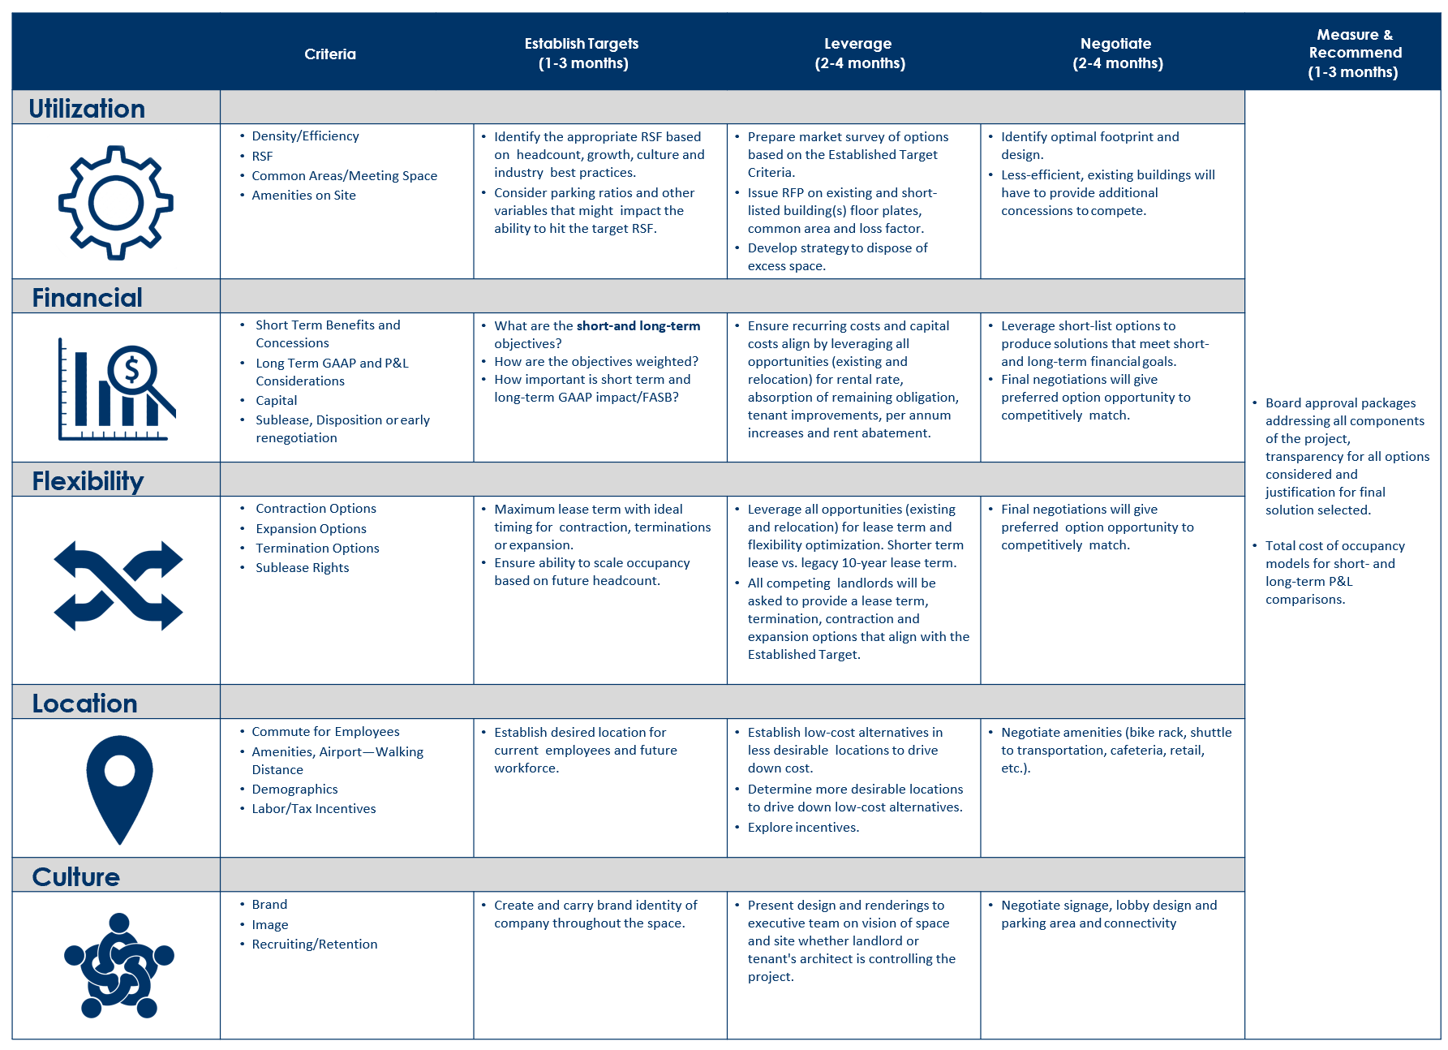
EXPERT EXECUTION
A NEW PLAN FOR REAL ESTATE

Slide 17
CONTACT INFO
Gregg Espach
Executive Managing Director
espach@vestian.com
T: 203.913.6214
Joe Mclaughlin
Managing Director
mclaughlin@vestian.com
T: 212.239.8400
Francine Niemiec
President - Account Services
niemiec@vestian.com
T: 312.880.4020
Jeremy Done
Managing Director
done@vestian.com
T: 214.394.8840

