Slide 1
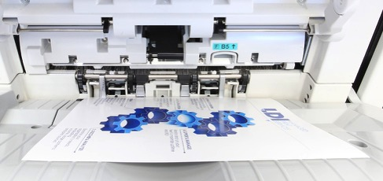
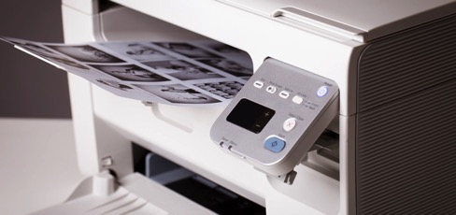

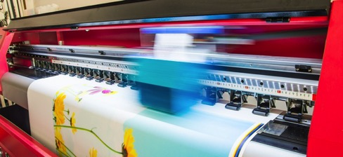
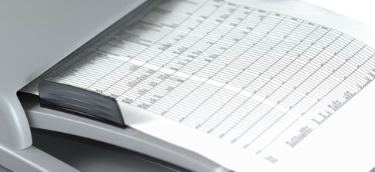
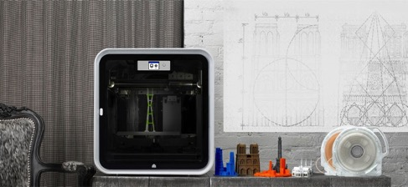


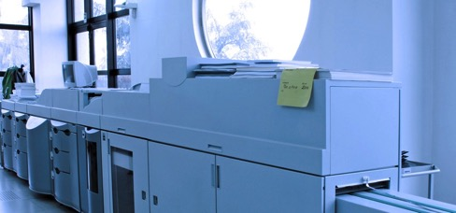
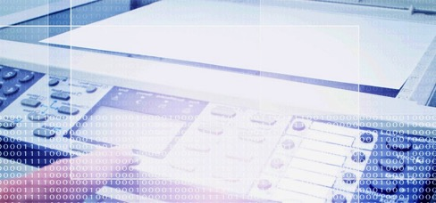
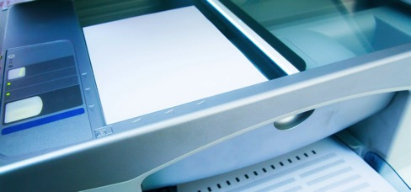


MANAGED PRINT SERVICES
DESKTOP PRINTERS
VISUAL DISPLAYS
WIDE FORMAT
DOCUMENT MANAGEMENT
3D CAPTURE AND PRINT
| REIMAGINING YOUR OFFICE FOR THE NEW NORMAL
MANAGED IT SERVICES
PRODUCTION PRINT
MULTI FUNCTION PRINTERS
WORKFLOW APPLICATIONS
COLOR GRAPHIC SOLUTIONS

Slide 2

WORDS FOR LIFE
Notes:
With all of the civil unrest, political divide stirring up our social and economic worlds, we are all called upon to give a little more of ourselves, be a better version of ourselves and understand how we fit into the communities and the world around us.
Business challenges are not a new story. They seem to come in cycles and sometimes even the worst of crises brings out the best in us.

Slide 3
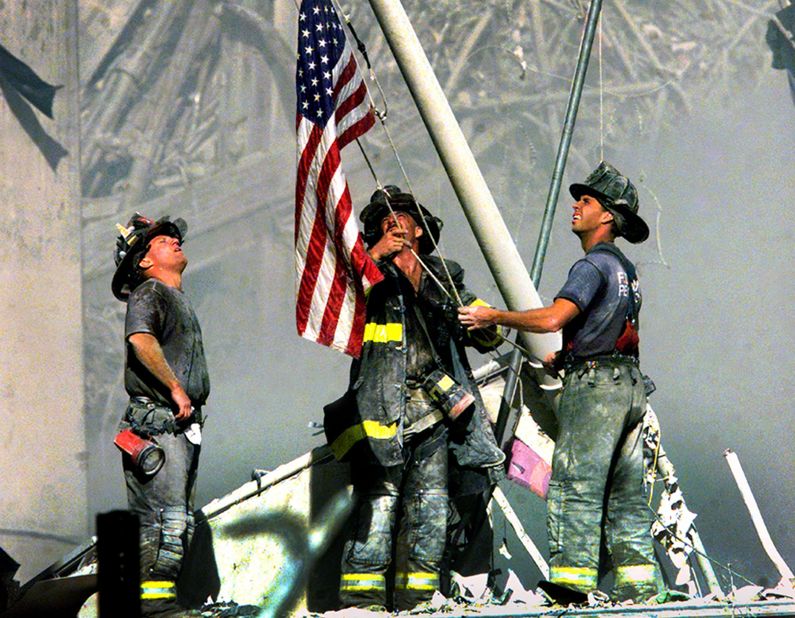
9/11 - A DAY TO REMEMBER
Notes:
Stephen to relate the 9/11 Deutsche Bank story.

Slide 4

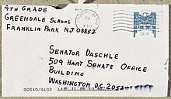
IS COVID-19 THE NEW ANTHRAX?
Notes:
LDI has a history providing solutions, even when the events are potentially catastrophic.

Slide 5




IS COVID-19 THE NEW ANTHRAX?

Slide 6
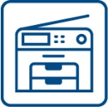









LDI CORE DISCIPLINES
MULTIFUNCTION DEVICES
MANAGED IT
COLOR GRAPHIC SOLUTIONS
PRO AV
PRODUCTION PRINT
UNIFIED COMMUNICATIONS
MANAGED PRINT
DOCUMENT MANAGEMENT
3D PRINT AND CAPTURE
DOCUMENT CONVERSION
Notes:
It’s nice to have skills and an extensive ‘ToolBox’ to draw on – especially when there is a crisis or pandemic!

Slide 7
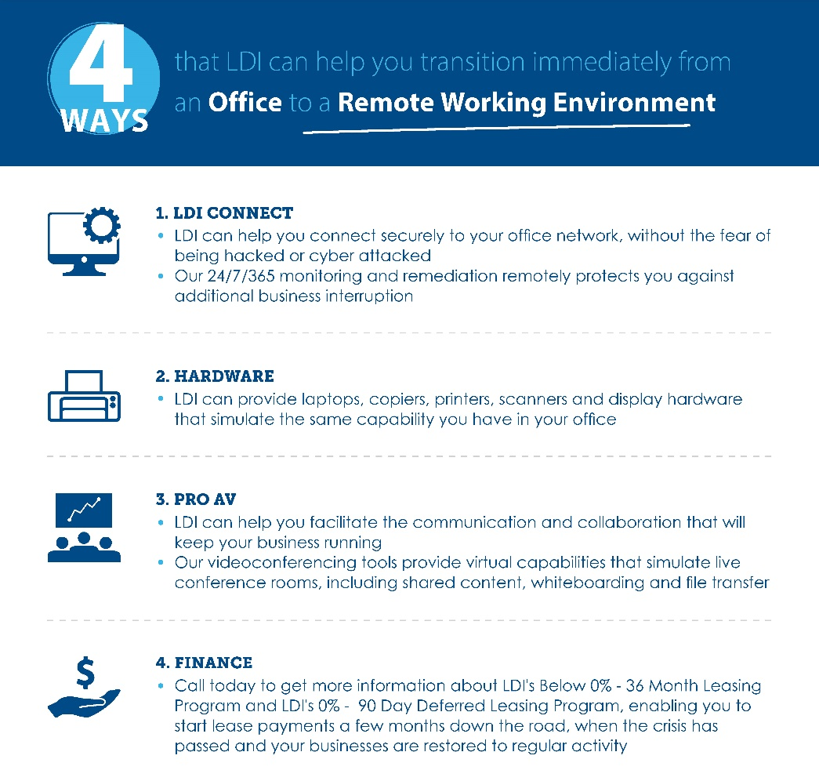
PANDEMIC RELIEF SOLUTIONS

Slide 8
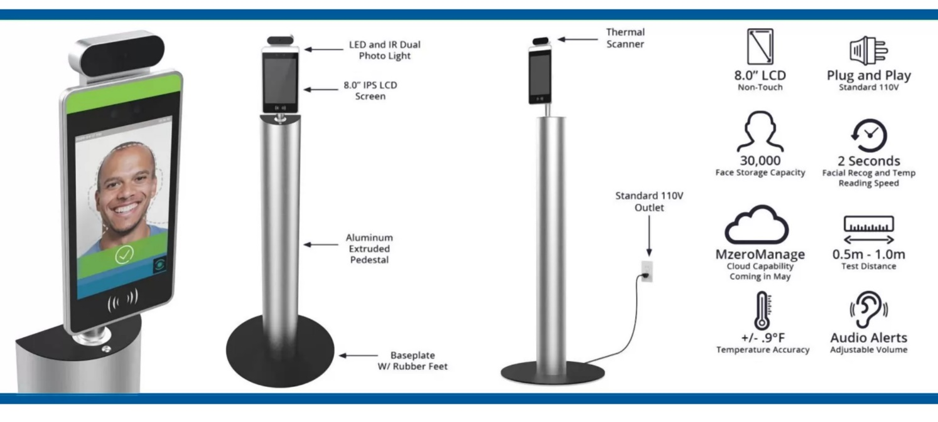
PERSONNEL AND VISITOR
MANAGEMENT SOLUTIONS
Did you know …
One of the best ways to secure the health and well being of people returning to your office is to set up a passive kiosk that can measure elevated temperatures?
Notes:
Me

Slide 9
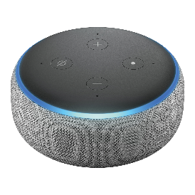
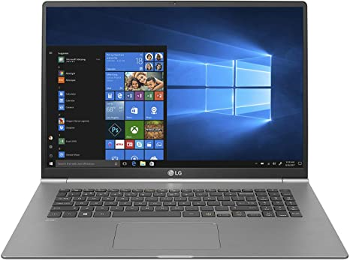
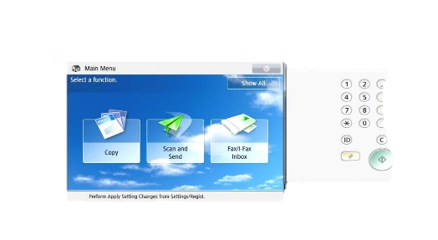
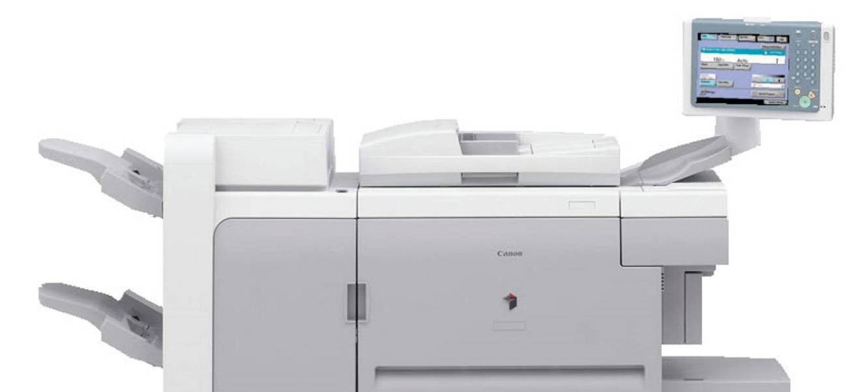
NON–TOUCH TECHNOLOGY SOLUTIONS
Did you know that some of the copiers and printers can be controlled remotely through your desktop, laptop or through voice activation?
Some devices feature voice activated copier commands utilizing Alexa-type voice recognition hardware
Some devices emulate the control panel and hard keys on your local computer screen, thereby allowing users to operate all system functions remotely and limiting contact with the publicly used control panel
Alexa, please make 3 color copies

Slide 10
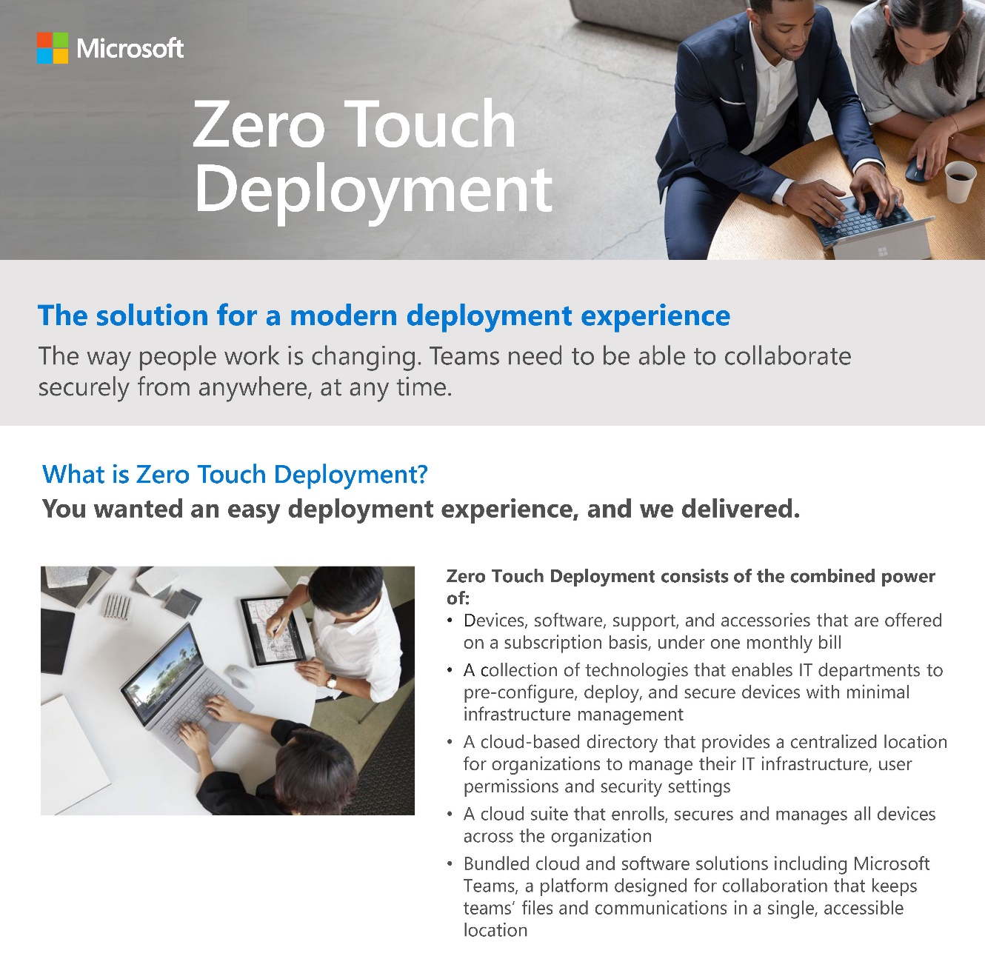
ZERO TOUCH DEPLOYMENT
Did you know that new desktops and laptops can be configured by using ‘Zero Touch Deployment’ techniques, limiting the amount of physical IT intervention required for configuration and accelerating the speed of delivery to your end user.

Slide 11
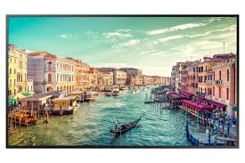
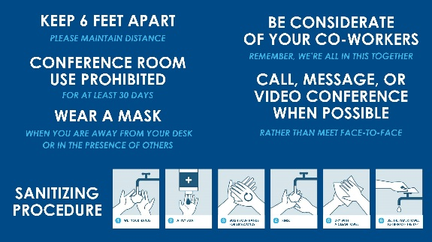

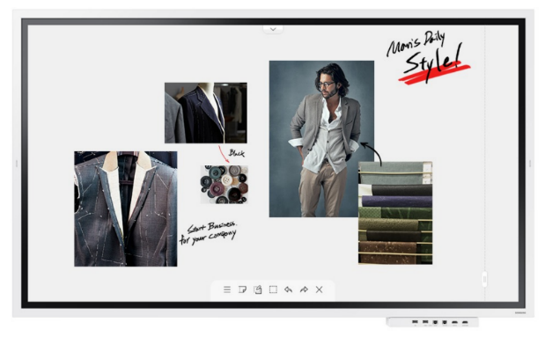

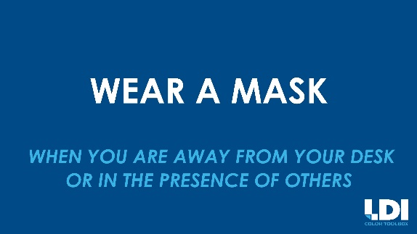
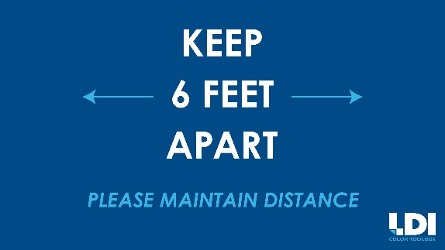
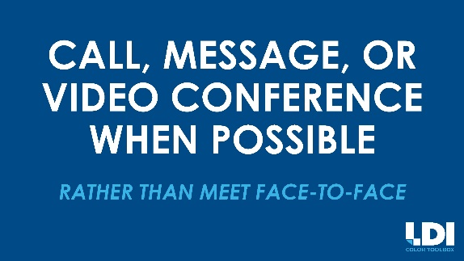
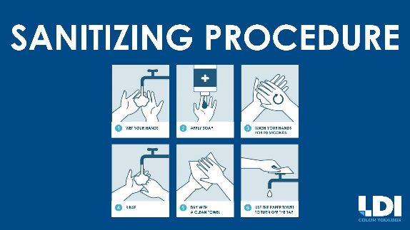

DIGITAL SIGNAGE
Did you know that Digital Signage and Content Management Systems are some of the best tools you have to centrally administer communications, inform and enforce regulations for:
Social Distancing
Office Schedules, Events and Reminders
Office Restrictions and Covid-related Policies
Visitor Information

Slide 12
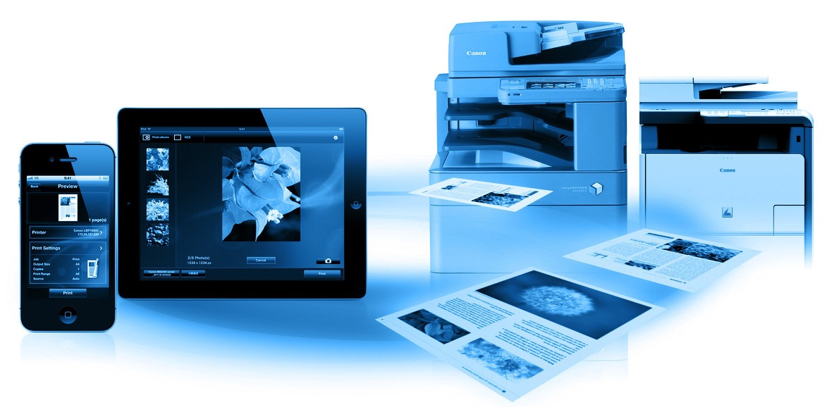
MOBILE SOLUTIONS
Using mobile devices such as smartphones, tablets, ultra computers and laptops can allow you to communication and print via the WiFi or the Cloud, without having to touch publicly used devices
LDI solutions can also allow you to control and account for all mobile printing via server-based solutions, with no need for print drivers. Users can simply send their documents by email, by uploading them to the web, or even directly from their smartphone using direct apps.

Slide 13

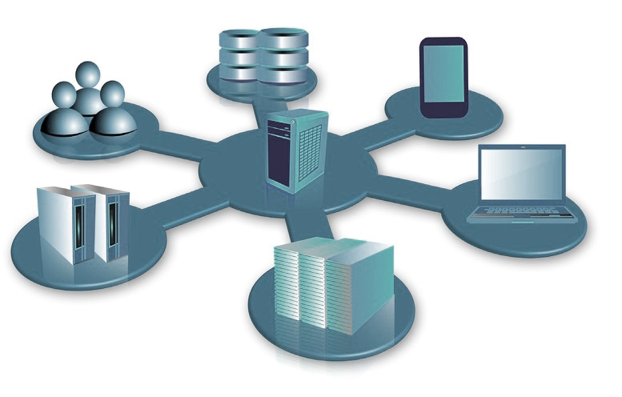
MANAGED IT SERVICES
TECHNICAL EXPERTISE ON DEMAND WORKING FOR YOU.
CIO/CTO Advisory
Application Support & Integration
Data Management, Reporting/Visualization
Systems Integration & Technical Support
CLOUD SERVICES
Cost-efficient IT solutions
with low overhead
24|7|365 assistance from knowledgeable support teams
Secure Data Center space for Production or Disaster Recovery
Hosted applications, including email, telephony, and data backup
Low latency proximity hosting

Slide 14
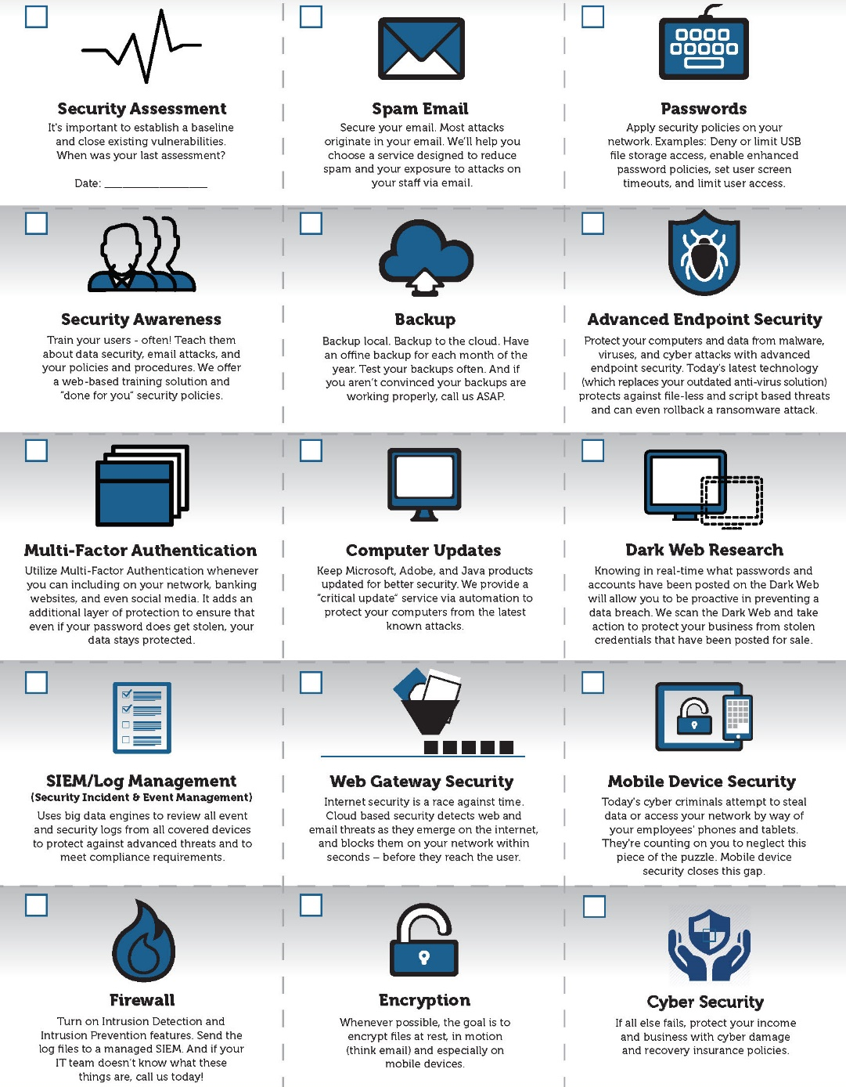
PROTECT YOURSELF
Did you know …
There is a marked increase in the number of cyber threats due to the pandemic and the rise of remote collaboration
1 in 5 Small businesses will suﬀer a cyber breach this year.
81% of all breaches happen to small and medium sized businesses.
97% of breaches could have been prevented with today’s technology.

Slide 15
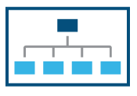
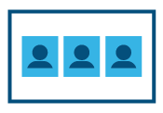



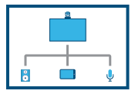
RETHINK YOUR COLLABORATION STRATEGY
LDI’s team of Pro AV Specialists can help you leverage innovative AV technology and are experts at designing and installing flexible solutions that bring together the audio, video, cloud, and data technologies to enhance your digital office, collaboration and communication.
LDI PRO AV DESIGN
System Design, Integration and Installation Services to create a seamless multimedia experience
VIDEO CONFERENCING
Conference Rooms, Huddle Spaces, Executive Boardrooms and Immersive Telepresence Systems
DIGITAL SIGNAGE/VIDEO WALLS
High Definition Digital Displays for Lobby, Reception Experiences with Informative Directory and Wayfinding Signage
INTEGRATED CLOUD AV SERVICES
Telepresence Capabilities with the latest cloud services from Intermedia, Microsoft, Zoom, Skype and Google
EXPERIENCED PRO AV SPECIALISTS
Technical staff is manufacturer and industry certified for all of the products we provide
VENDOR AGNOSTIC PRODUCT STRATEGY
LDI maintains elite level partnerships with the most trusted audiovisual equipment manufacturers in our industry.

Slide 16
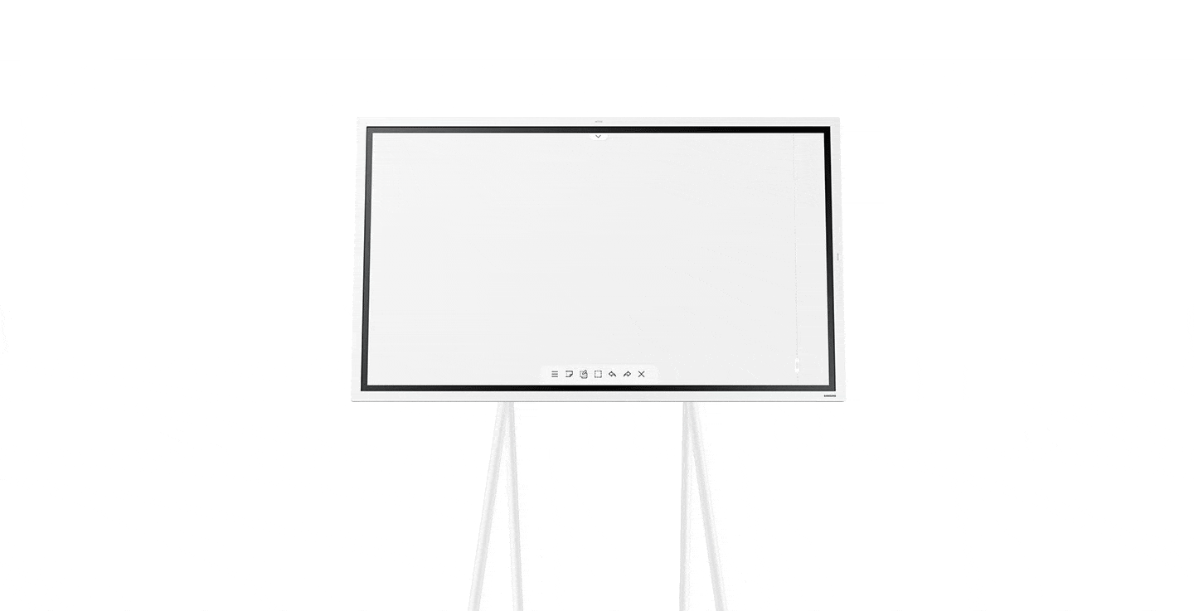
HUDDLE UP COLLABORATION
The Samsung Flip is an innovative digital flipchart that helps to drive more productive and efficient business collaboration without the hassle. With the Samsung Fl!P interactive UHD display, your team can work smarter, faster and better.
Business meetings can take place anywhere, anytime, and you can take the stress out of the logistics. Interactive display features from note-taking to intuitive navigation enables creative thinking in business meetings
Versatile connectivity and an ergonomic design promote business collaboration
Innovative touch display technology for smooth writing plus UHD picture quality for precise visuals
Portable, wheel-based stand empowers you to start a meeting anywhere, anytime

Slide 17
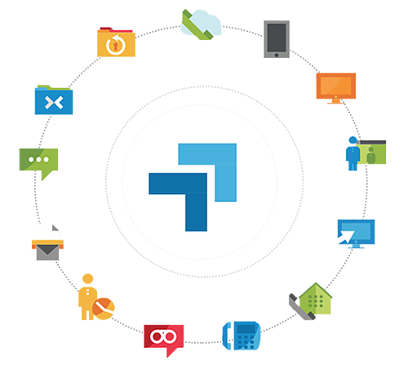
RETHINK AND REIMAGINE YOUR COMMUNICATION STRATEGY
LDI ELEVATE is an easy-to-use cloud-based unified communications solution that helps companies and organizations to be more productive and collaborative.
LDI ELEVATE:
seamlessly integrates all your communication tools – desktop phones, mobile phones, and computers
includes a full-featured phone system with chat, videoconferencing, collaboration and backup
is compatible with most operating systems and smart devices
transcribes voicemail messages to text
enables calls and meetings to be recorded for downloading, reviewing and sharing.
reduces infrastructure and operating costs by consolidating voice and data onto one network with redundancy
includes over 100+ enterprise-grade calling features.

Slide 18
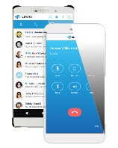
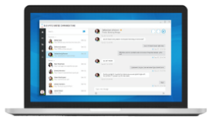
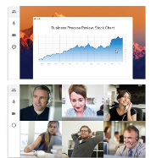
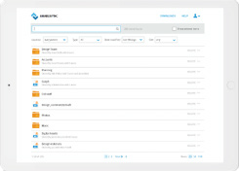
RETHINK AND REIMAGINE YOUR COMMUNICATION STRATEGY
 | LDI ELEVATE MOBILE transforms your phone into an essential collaboration tool, making teamwork on-the-go easier than ever. See who is available, chat with colleagues, and manage voicemails - anytime, anywhere.
 | LDI ELEVATE DESKTOP brings essential collaboration tools together so employees can see who is available, chat with colleagues, place and receive calls, share screens, start video calls and share files - all from one application.
 | LDI ELEVATE MEETING & VIDEOCONFERENCING includes easy-to-use, reliable meeting and video collaboration.
 | LDI ELEVATE FILE SHARING & SECURITY enables file sync and sharing with backup for desktops, mobile devices, and file servers.
Notes:
LDI ELEVATE MOBILE transforms your phone into an essential collaboration tool, making teamwork on-the-go easier than ever. See who is available, chat with colleagues, and manage voicemails - anytime, anywhere.
Extend your business phone number and extension to your mobile phone, so you can place and receive calls on- the-go or even transfer calls from your desktop phone to your mobile device - seamlessly, without interruption.
Your full desktop chat history is synchronized with your mobile device so you can stay connected and continue conversations no matter where you are.
LDI ELEVATE DESKTOP brings essential collaboration tools together so employees can see who is available, chat with colleagues, place and receive calls, share screens, start video calls and share files - all from one application.
Have the flexibility to use your desktop application to place and receive calls in two ways, either as a call controller for your associated desk phone or as a softphone from your PC or Mac.
One place to see the availability of coworkers, place a phone call, start team chat and launch a video conference.
With the Elevate UC desktop and mobile applications, you take your contacts, files, and conversations with you - wherever you are.
LDI ELEVATE MEETING & VIDEOCONFERENCING includes easy-to-use, reliable meeting and video collaboration.
HD video conferencing eliminates unnecessary travel and empowers teams with remote members to be more productive.
The computer desktop can be shared with team members in real time, improving collaboration and speed of decision making.
Meetings and Videoconferences include a conference dial-in number and customized URL.
LDI ELEVATE FILE SHARING & SECURITY enables file sync and sharing with backup for desktops, mobile devices, and file servers. It also includes:
the most current version of files from any device.
easy and secure file sharing.
integration with Windows File Server, Exchange, Outlook, Active Directory, Office, and Office 365.
full control over files, users, devices, and sharing activities.

Slide 19
CLOSING REMARKS
“Option A is not available. So let’s kick the sh** out of option B.”
– Sheryl Sandberg , COO of Facebook
“The greater the difficulty, the more glory in surmounting it. Skillful pilots gain their reputation from storms and tempests.”
– Epicetus
“In three words I can sum up everything I’ve learned about life. It goes on.” – Robert Frost

Slide 20
