Slide 1
Return to Office Considerations and Employment Law Update
Presented to the NYC Chapter of the Association of Legal Administrators
by
Dean L. Silverberg, Esq.
June 9, 2020
NY:49164394V1

Slide 2
Dean L. Silverberg, Esq.
Member of the Firm
dsilverberg@ebglaw.com
212-351-4642

Slide 3
Return to Office Considerations
Introduction: Why Your Law Firm Needs a Reopening Plan
Your Reopening Plan: Carefully Plan the Plan!
Your Reopening Plan: Health and Safety Protocols
Employment Law Considerations
Employment Law Update

Slide 4
Return to Workplace Considerations

Slide 5
Introduction: Why Your Law Firm Needs a Reopening Plan

Slide 6
Why You Need a Reopening Plan
“Unprecedented” event
Understanding of the virus is evolving
Law and government guidance is evolving
Workplace and workforce will need to be reimagined (at least temporarily)
To what extent?
Many “moving parts” – e.g., testing
Who gets tested?
Symptomatic employee?
Asymptomatic employee “exposed” to COVID-19 positive person?
Now: CDC estimates about 40% of asymptomatic people transmit virus to others
A plan will help you navigate these uncharted waters
Needs to be flexible and allow for rapid response to new developments

Slide 7
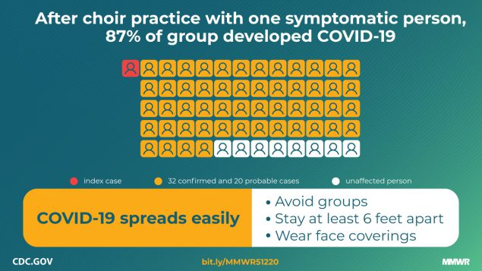
Why You Need a Plan: Understanding of the Virus is Evolving
Then: Virus not “airborne” – so focus on surfaces;
Didn’t need face coverings
Now: Virus “not easily” spread through surfaces – Wear face covering!
But, still need hand washing? Yes!
But, not all face coverings created equal?
Then: Droplets don’t survive long in the air
Now: Can live considerably longer than originally thought
Then: Distancing of 6 feet
Now: Is 6 feet really sufficient?
Only outdoors? More indoors?
What if contact is prolonged?
If person coughs? Sneezes? Yells?

Slide 8
Why You Need a Plan: Law and Guidance Are Evolving
Federal
EEOC issued updated guidance on COVID-19 related discrimination, accommodation, testing, etc. 6 times between March 17 and May 7
Some guidance issued on May 5 was immediately retracted; revised guidance was released two days later
OSHA issued a new policy on COVID-19 reporting and recordkeeping obligations in April and reversed itself in May
New guidance, rules, etc. emerge on an almost daily basis from CDC, USDOL or another federal agency
Congress passed two major laws – FFCRA and CARES Act – in the span of 8 days!!!
New York
Executive Orders: Since March 7, Governor Cuomo has signed 36 EOs on the pandemic (as of 6/1/20)
Legislature passed COVID-19 related paid leave law
Executive Branch has issued extensive guidance, including, most recently, Phase 2 of “New York Forward”

Slide 9
Your Reopening Plan: Carefully Plan the Plan!

Slide 10
Considerations Before Employees Arrive (Overview)
Bringing back the workforce
Phased-in reopening? Recommended!
Voluntary? If so:
Questionnaires?
Who does/does not want to return right away?
How will you handle high-risk employees who do/do not want to return?
Instruct employees who are successfully teleworking to continue to do so?
Consider part-time telework/part-time onsite?
Stagger day/week schedules, e.g., Teams A, B, C work alternating days/weeks?
Training for all employees and managers
New safety and capacity rules
New company policies/procedures
Changes to the office
Physical changes, e.g., one-directional hallways, partitions, etc.
Process changes, e.g., eliminate communal equipment, revise mail delivery system

Slide 11
Considerations Before Employees Arrive (cont’d)
Create a Return-to-Office Management Team
Include: HR, IT, Legal, Security, Office Management, etc.
Identify who will oversee each aspect of the transition process, e.g.:
Select employees – who returns first?
Design a safety program – who will:
Oversee implementation?
Conduct employee training?
Ensure employee privacy rights?
Evaluate/oversee structural/design changes to workspace
Handle employee communications
Identify employee contact person
Address transportation issues
Develop “what if” protocols, e.g.,
Employee refuses to return to work
Employee refuses to leave office after exhibiting symptoms
Ensure coordination among team members

Slide 12
What Will the Workplace Look Like?
COVID-19’s Impact
Fewer employees: many employees will continue to work from home
One-way hallways (e.g., clockwise flow only); floor markings (including six-foot indicators)
Sneeze guards at reception desk, spread out employees (blocked out cubicles)
Elimination of community equipment (printers, refrigerators, coffee machines)
New “no touch” equipment (garbage, key fobs, doors)
Altered schedules (Team A/B; multiple offices; staggered schedules)
Social Distancing (offices, conference rooms, trading floors, cafeterias)
Ventilation changes – increased air flow, include outside air

Slide 13
Your Reopening Plan: Health and Safety Protocols

Slide 14
New York Forward, Phase II: You Must Have a Compliant Safety Plan! Guidelines for Office-Based Work
Mandated!
Written (may use NYS DOH template)
Applies to essential and non-essential businesses
Affirmation
No waivers, e.g., unable to obtain PPE (ESD FAQs)
Must comply with the minimum state standards, plus applicable federal laws and agency guidance
May adopt “additional precautions or increased restrictions,” as long as allowed by law/regulations
Anticipate updates/revisions to mandates – employer obligated to comply
Designate a SITE SAFETY MONITOR for “continuous compliance with all aspects of the site safety plan”
Required training of “ALL PERSONNEL” on new protocols and frequently communicate safety guidelines

Slide 15
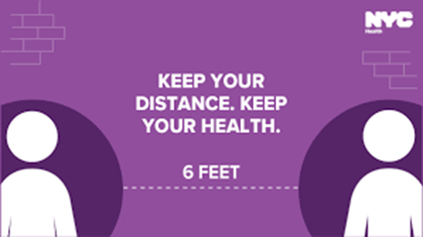
“New York Forward, Phase II:” Elements of the Safety Plan Guidelines for Office-Based Work
Physical Distancing: Must take measures to reduce interpersonal contact and congregation
Limit total number of occupants to no more than 50% of maximum occupancy “for a particular area”
Must restrict access to areas at maximum capacity
Limit in-person gatherings to maximum extent possible;
If/when held:
Ensure well-ventilated spaces
Maintain appropriate social distancing among participants
Limit occupancy of tightly confined spaces (e.g., elevators) to one person at a time; if not feasible:
Limit to 50% of capacity, and
Require all occupants to wear face coverings

Slide 16
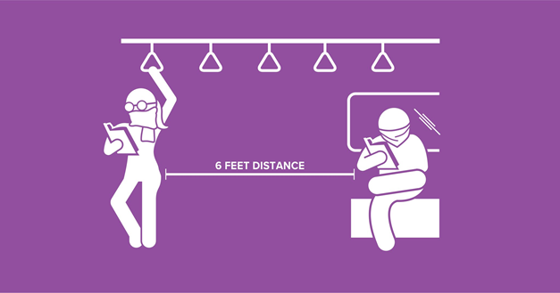
Elements of the Safety Plan: Physical Distancing (cont’d)
Physical distancing protocols
“Six feet of separation” rule, unless safety of the “core activity" requires a shorter distance
If an employee/visitor comes within six feet of another person, MUST wear face covering
Workers and visitors MUST wear face coverings in common areas , e.g., elevators, lobbies, and when traveling around the office
Redesign layout to create greater separation, if possible
When distancing not feasible between workstations, MUST provide and require use of face coverings or install physical barriers (e.g. plastic shielding walls), per OSHA rules
If shared workstations (e.g., “hot-desks”) unavoidable, must be cleaned and disinfected between users
Post distancing markers/signs in common areas
Close non-essential common areas (e.g., gyms, pools, game rooms)
Designate areas for pickups and deliveries to minimize contact

Slide 17
“Best Practices:” Recommended Distancing Protocols (Not Mandatory)
Phase in reopening – to work out glitches
Restrict onsite workforce to “necessary staff”
Stagger work schedules
Adjust work hours
Encourage WFH
Limit non-essential travel
Create separate entrances and exits
Create one-way halls
Require employees to stay near their workstation as much as possible
Leverage technology, e.g., room sensors and real-time dashboards, to assess use of space
Mark six feet distance circles around workstations and other common stationary work areas.
Prohibit non-essential visitors

Slide 18
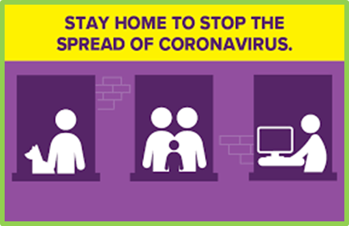
Elements of the Safety Plan: WFH Best Practices (Not Mandatory)
Conduct regular employee surveys
Determine what practices are working and what can be improved
Take employee’s emotional temperature on WFH
Provide guidance on enhancing remote work experience
Set boundaries, where appropriate, on start/stop times, breaks, etc.
Also:
Ensure regular communications with teleworkers
Formal and informal, e.g., virtual “coffee break” get-togethers
Keep on top of potential legal pitfalls (discussed later)

Slide 19
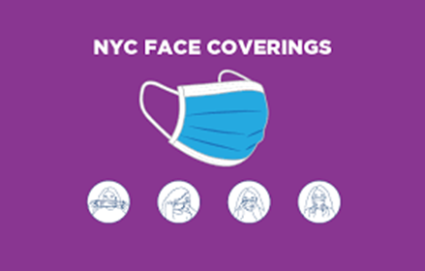
Elements of the Safety Plan: PPE and Hygiene
Provide PPE, including:
Appropriate face covering, free of charge
No sharing! Ever!!
Provide gloves, where appropriate
Applies to employees and contractors
Train employees on donning, doffing, and caring for their PPE
Hygiene and cleaning protocols
Provide handwashing stations and hand sanitizers
Conduct regular (e.g., daily) cleaning and disinfection of the facility (follow CDC & OSHA guidance)
Maintain a cleaning log
Limit sharing of equipment, tools, etc.
Prohibit shared food and beverages (e.g., no more buffet style meals); encourage bringing food from home
Consider touch-free amenities, such as trash-cans and hand-dryers

Slide 20
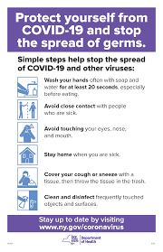
Elements of the Safety Plan: Communications and Postings
Implement communication practices
Establish a communication plan for employees (including contractors), visitors, and clients
Post signage throughout office detailing safety plan and employees’ obligation to adhere to its mandates
Use DOH COVID-19 posters or create own
Signage should remind individuals to:
Cover their nose and mouth with a mask or cloth face-covering when six feet of social distance cannot be maintained
Properly store and, when necessary, discard PPE
Adhere to physical distancing protocols
Report symptoms of or exposure to COVID-19, and how they should do so
Follow hand hygiene and cleaning and disinfection guidelines
NYC posters are available at https://www1.nyc.gov/site/doh/covid/covid-19-posters-and-flyers.page

Slide 21
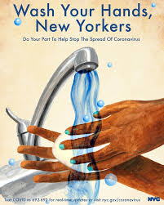
Encourage Proper Behavior
No hand shaking, hugging, etc.
No printing unless absolutely necessary (avoid use of community printers)
Use of disposable desk blotters (and any other kinds of disposable materials/equipment
No candy jars/bowls, leftovers in lunchroom
Encourage employees to be kind – this is new and tough for everyone!
If someone acts inappropriately, “gently” remind him/her of protocol or speak with HR
We’re all in this together!

Slide 22
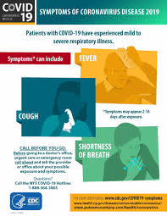
Elements of the Safety Plan: The Screening Process
Must conduct DAILY health screening assessment of all employees, contractors, and visitors
E.g. questionnaire, temperature check
Before employees begin work and for “essential visitors”
May be done remotely (phone; electronic survey)
Create a COVID-19 screening process
Questionnaire: Has individual in past 14 days:
Knowingly been in close contact with COVID-19 positive person or symptomatic individual?
Tested positive for COVID-19?
Has had any symptoms of COVID-19?
May conduct daily temperature checks consistent with law
Review and document all employee and visitor responses
BUT: Prohibited from “keeping records of employee health data (e.g. temperature data)” (Conflict?)
Require employees to immediately disclose if/when experience symptoms
Get a contact name from employee
Designate a company contact for employees

Slide 23
CDC Updates COVID-19 Symptoms List
The CDC recently added gastrointestinal symptoms
The list of symptoms as of May 27, 2020, includes the following:
Fever or chills
Cough
Shortness of breath or difficulty breathing
Fatigue
Muscle or body aches
Headache
New loss of taste or smell
Sore throat
Congestion or runny nose (new symptom)
Nausea or vomiting (new symptom)
Diarrhea (new symptom)
CDC: Other symptoms possible; list may be updated

Slide 24
Elements of the Safety Plan: Protocols Based on Screening Results
Sick employees should stay home or return home
if they become ill at work, conduct screening assessment
If a person has COVID-19 symptoms AND EITHER tests positive OR did not receive a test:
14 days of self-quarantine (and get tested)
If does NOT have COVID-19 symptoms BUT tests positive:
14 days of self-quarantine
If had close contact with a COVID-19 positive person AND is symptomatic:
14 days of self-quarantine (consult doctor/get tested)
If had close contact with a COVID-19 person AND is NOT symptomatic:
14 days of self-quarantine (limited exception for “critical” workers, i.e., workers critical to the operation or safety of the office)
Develop a plan for cleaning and disinfection in the event an employee tests positive for COVID-19

Slide 25
Elements of the Safety Plan: Contact Tracing and Tracking
Must notify local health department immediately upon being informed of an employee’s positive COVID-19 test result
Also notify building management/provide log info
To “extent possible,” maintain a continuous log of “every person who may have close contact with other individuals at the work site”
Cooperate with local health department as required to trace all contacts in the workplace
Provide info on “all employees and visitors at site dating back 48 hours before employee first experienced COVID-19 symptoms or tested positive, whichever is earlier”
Maintain confidentiality per federal /state law
Notify building management if employee or visitor shows symptoms, and of where the individual has been in the building
Follow-up if the symptomatic employee tests positive
Local health department will implement monitoring and movement restrictions of infected or exposed persons, including home isolation or quarantine

Slide 26
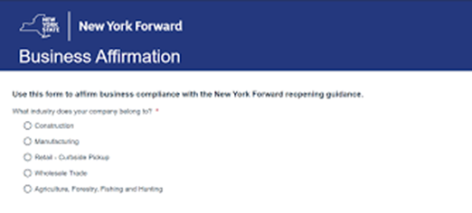
Elements of the Safety Plan: Business Affirmation
“I am the owner or agent of the business listed. I have reviewed the New York State interim guidance for business re-opening activities and operations during the COVID-19 public health emergency and I affirm that I have read and understand my obligation to operate in accordance with such guidance.”

Slide 27
Employment Law Considerations

Slide 28
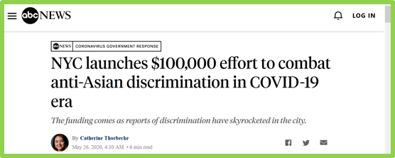
Discrimination and Harassment Issues in the Era of COVID-19
Discrimination/harassment claims:
In connection with reductions in force, selection for furlough, return from furlough
Disability discrimination – Failure to accommodate
National origin harassment
NYCCHR: From Feb. 1 through May 15, 2019, they received 11 complaints of anti-Asian discrimination; for the same time period this year, they have received 250+ such complaints

Slide 29
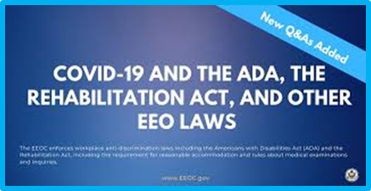
Reasonable Accommodation of “Vulnerable Employees”
EEOC’s Updated Guidance
Are underlying conditions and bases for compromised immune systems disabilities?
Precluding “vulnerable” employees from entering the workplace – permissible?
Age – not a disability, but a basis for accommodation?
What about “vulnerable” household/family members – accommodations required?
If no “vulnerability,” accommodation required?
Don’t forget mental health issues – disability caused or exacerbated by pandemic – EEOC Guidance
Elevated requirements under NYS and NYC law?
If no legal obligation, should employers accommodate anyway?
Be consistent
Consider unemployment insurance eligibility implications

Slide 30
Vulnerable Employees and Remote Working Considerations
Can all job duties be performed remotely?
If not, burden will be on employer to prove
Undue hardship
Consistent enforcement
If not, can we separate “in-office” responsibilities, and:
Have employee come in one day a week to perform same?
Redistribute job duties so that “in-office” duties are no longer part of the employee’s job?

Slide 31
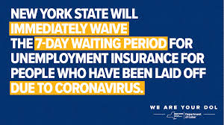
New York Unemployment Insurance
If unable to work due to COVID-19 related reason, employee is eligible for UI
March 2020: Governor Cuomo Executive Order
Eliminates 7-day waiting period for UI claimants whose claims arise directly out of closings of schools or other workplaces in which claimants were employed, or out of claimants’ isolation or quarantine in connection with COVID-19
If unable to work due to COVID-19 related reason, employee is eligible for UI
CARES Act Law provides an additional $600 per week, on top of regular benefits, to all UI and Pandemic Unemployment Assistance (“PUA”) recipients
PUA also extends benefits to individuals who have traditionally been ineligible for Unemployment Insurance benefits (e.g., self-employed worker and independent contractors
The period covered by unemployment benefits extended for another 13 weeks, for a total of 39 weeks

Slide 32
Layoffs and Furloughs: Is Workshare an Alternative?
Workshare programs allow groups of workers to collect partial unemployment benefits while working reduced hours
Employers are normally responsible for covering half the costs for these programs
But: Recent US DOL guidance: states can “choose not to charge” employers for these programs in certain circumstances
NY: Your Shared Work Plan must:
Include only employees who normally work no more than40 hours per week
Reduce work hours and corresponding wages between 20% and 60%
Replace the layoff of an equal percentage of your workforce
Not reduce or eliminate fringe benefits, unless they are reduced or eliminated for the entire workforce
Not extend beyond 53 weeks
Cover all employees in an affected unit and reduce their hours by the same percentage (can reduce different units by different percentages)

Slide 33
Other Liability Concerns
Wage and hour concerns: compensation for temperature testing; change in exempt status due to pay reductions; call-in pay concerns; overtime uncertainty with remote working; reimbursement for equipment during remote working periods (different state rules)
NLRA concerns: protected, concerted activity; are we creating a breeding ground for unions?
FFCRA, FMLA, other leave requirements: sick time, expanded FMLA leave under FFCRA; NYS sick time law; existing sick time rules
OSHA concerns: is your workplace safe; reporting requirements; negligence standards and creating a workplace free of “recognized hazards”

Slide 34
Cyber and Other Tech Considerations
Cybersecurity
Prepare risk assessment and cybersecurity plans for remote workforce
Consider requiring multi-factor authentication
Enhance “BYOD” security/policies
Assess risks associated with cloud-based computing
Plan for threats/security incidents
Encryption of devices
Privacy and Data Security Concerns
Ensure that maintaining certain health-related information does not violate international (if applicable) and domestic data security/privacy laws
Employee Monitoring Concerns
If you are considering spyware/surveillance/ keystroke logging, consider possible claims under the Stored Communications Act, state or local social media password protection laws, and other consumer protection laws like the CA Consumer Protection Act
Biometrics Laws
If considering the capturing of biometric data, be mindful of various state biometric laws, in particular, those in IL, WA, and TX.
Consent and/or prior notice may be required

Slide 35
Epstein Becker Green Coronavirus Resource Center
Epstein Becker Green Coronavirus News and Updates
Employers throughout all industries, and particularly those within health care, are now grappling with how to deal with the various implications of the coronavirus (COVID-19) on their businesses and workforce.
Please see below for our latest news, subscribe for email notifications, and revisit for updates.
Health Care & Life Sciences |  | Workforce Management
https://www.ebglaw.com/coronavirus-resource-center/

Slide 36
Employment Law Update

Slide 37
New York Enacts Paid Sick Leave Law
Sept. 30, 2020: Employees begin accruing sick leave
Jan. 1, 2021: Employees may start taking sick leave
Applies to all private employers and all employees
Exempted if current sick leave or time-off policies meet minimum requirements (including accrual, carryover, and use)
Level of leave depends on employer’s size and net income
If not frontloaded, accrue one hour for every 30 hours worked, to maximum allowed in a calendar year::
4 or fewer employees & net income of $1 million or less: up to 40 hrs. unpaid leave
4 or fewer employees & a net income greater than $1 million: up to 40 hrs. paid leave
5 - 99 employees: up to 40 hours paid leave
100 or more employees: up to 56 hours paid leave
Carryover required but can cap annual use to 40/56 hrs. per year
Reasons for use:
Employee’s, or family member’s, mental or physical illness, injury or health condition, regardless of whether condition has been diagnosed or requires medical care at time of leave request
Attend to matters related to domestic violence, a sexual offense, stalking, or human trafficking (involving employee or family member)
Employer must respond to leave request within 3 business days
Recordkeeping requirements

Slide 38
New York Again Revises Paid Election Leave Law
2019: NY expanded employee PTO to vote on Election Day from to 2 to 3 hours
April 3, 2020: Back to earlier rule:
If employee is a registered voter without “sufficient time” outside of scheduled working hours to vote, employee may take up to 2 hours of PTO from work
“Sufficient time” = 4 consecutive hours between polls opening and beginning of work shift, or 4 consecutive hours between end of shift and polls closing
If employee lacks sufficient time, allowed as much time as needed, but paid for only 2 hours
Employer may require time be taken at the beginning or end of employee’s shift
Employee must provide notice at least 2, but no more than 10, working days before Election Day
Employers must post notice of the law in a conspicuous location not fewer than 10 days before election
Must be kept posted until close of polls on Election Day

Slide 39
Reminder: 2020 Effective Dates for New NY Discrimination and Harassment Laws
Effective January 1, 2020
Required Notice of Employees’ Disclosure Rights in Employment Contract NDAs (including confidentiality agreements issued at the time of hire)
A confidentiality provision in an employment contract that prevents an employee from disclosing “factual information related to any future claim of discrimination” is void and unenforceable, unless the provision informs the employee or prospective employee that the employee is not prohibited from speaking with law enforcement, federal, state, or local human rights agencies, or an attorney
Effective February 8, 2020
Expansion of the term “employer” under the Human Rights Law to include all employers within NYS
Effective August 12, 2020
Extension of the statute of limitations to file sexual harassment claims with administrative agency from 1 year to 3 years (has been the law in NYC since 5/9/2018)

Slide 40
Guidance Issued as NYS Salary History Inquiry Ban Goes into Effect
Effective January 6, 2020: NYS bans salary history inquiries
Prohibits all New York State employers from:
Relying on job applicant’s salary history in determining whether to offer employment or in deciding the salary to offer (with exception below)
Requesting applicant’s or current employee’s salary history as a condition to being interviewed or offered job, or as a condition of employment or promotion, unless required by law
Seeking applicant’s or employee’s wage history from another or former employer
Refusing to interview, hire, or promote, or otherwise retaliating against, an applicant or current employee
2020 Guidance
May consider salary history in determining salary to offer if it is disclosed voluntarily and without prompting
“Salary history information” includes “compensation and benefits”
“Applicant” includes “part-time, seasonal and temporary workers, regardless of their immigration status”
Employers may inquire into an applicant’s salary expectations
Some significant differences from NYC law

Slide 41
NYC Issues Guidance on Independent Contractor Protections under Human Rights Law
Effective January 11, 2020:
“Employment” protections extended to freelancers and ICs under NYCHRL
Protected against discrimination, harassment, and retaliation
February 2020: NYCCHR Factsheet:
Freelancers and Ics
Must receive annual sexual harassment prevention training if they work in NYC
for an employer of 15 or more people (including both employees and freelancers/ICs)
more than 80 hours in a calendar year, and
for at least 90 days (not necessarily consecutive days)
Note: Provide freelancers and ICs with the NYC sexual harassment prevention information sheet when they are engaged
Are entitled to reasonable accommodations under the NYCHRL for needs related to disabilities, pregnancy, lactation, religious observances, and status as victims of domestic violence, sexual offenses, or stalking
Note: Provide such workers with NYCCHR’s pregnancy accommodation notice upon engagement

Slide 42
NYC Ban on Pre-employment Marijuana Testing
Effective May 10, 2020: NYC employers may not require job applicants to submit to a marijuana or THC drug test as a condition of employment
Bans only pre-employment testing for marijuana – no other substances
May still test employees
Exceptions, e.g.:
Where testing required by federal or state law “for purposes of safety or security”
Positon involves supervision of children or medical patients
FAQs issued May 8, 2020
Clarify that law does not limit employers’ ability to ensure that their workplaces remain drug-free
More safety-related exceptions to be added

Slide 43
Suffolk County ‘Bans the Box’
Effective August 25, 2020: Prohibit employers with 15 or more employees from inquiring into a job applicant’s criminal convictions before completing the “application process” and job interview
If employer does not conduct an interview, employer must inform applicant whether a criminal background check will be conducted before employment is to begin
“Applicant” includes applicants for temporary or seasonal work, contracted work, contingent work, and work through a temporary or other employment agency
Several exceptions, e.g., if such inquiry required by law
Must comply with Article 23-A of the NYS Correction Law when considering an applicant’s prior criminal convictions in determining suitability for employment
Note: Law is not as broad as NYC’s Fair Chance Act, which bars such inquiries until after the employer has made a conditional offer of employment
Note: Westchester County ban the box law went into effect on March 4, 2019 – only restricted from asking about criminal history on the employment application
The Law, however, is not as broad as New York City’s Fair Chance Act, which bars such inquiries until after the employer has made a conditional offer of employment

Slide 44
Please Note:
This presentation has been provided for informational purposes only and is not intended and should not be construed to constitute legal advice. Please consult your attorneys in connection with any fact-specific situation under federal, state, and/or local laws that may impose additional obligations on you and your company.
Attorney Advertising

