Slide 1
PPP Loan Forgiveness:
Paycheck Protection Program Flexibility Act
June 16, 2020
Presentation to Association of Legal Administrators (ALA)

Slide 2
Speakers
Alan Wink
Craig Rothman
Jon Zefi
Managing Director
Audit Partner
Principal
EisnerAmper LLP
EisnerAmper LLP
EisnerAmper LLP
Alan.Wink@eisneramper.com
Craig.Rothman@eisneramper.com
Jon.Zefi@eisneramper.com

Slide 3
EisnerAmper At a Glance
Audit, accounting, tax, and business advisory professionals serving public and private companies across a broad range of industries.
Top 20
200
$410m
19
1,900+
200+
Largest Accounting & Business Advisory Firms in the U.S.*
Public Companies
Annualized Revenue
Offices
EisnerAmper Employees
EisnerAmper Partners
*Accounting Today’s 2019 Top 100 firms

Slide 4
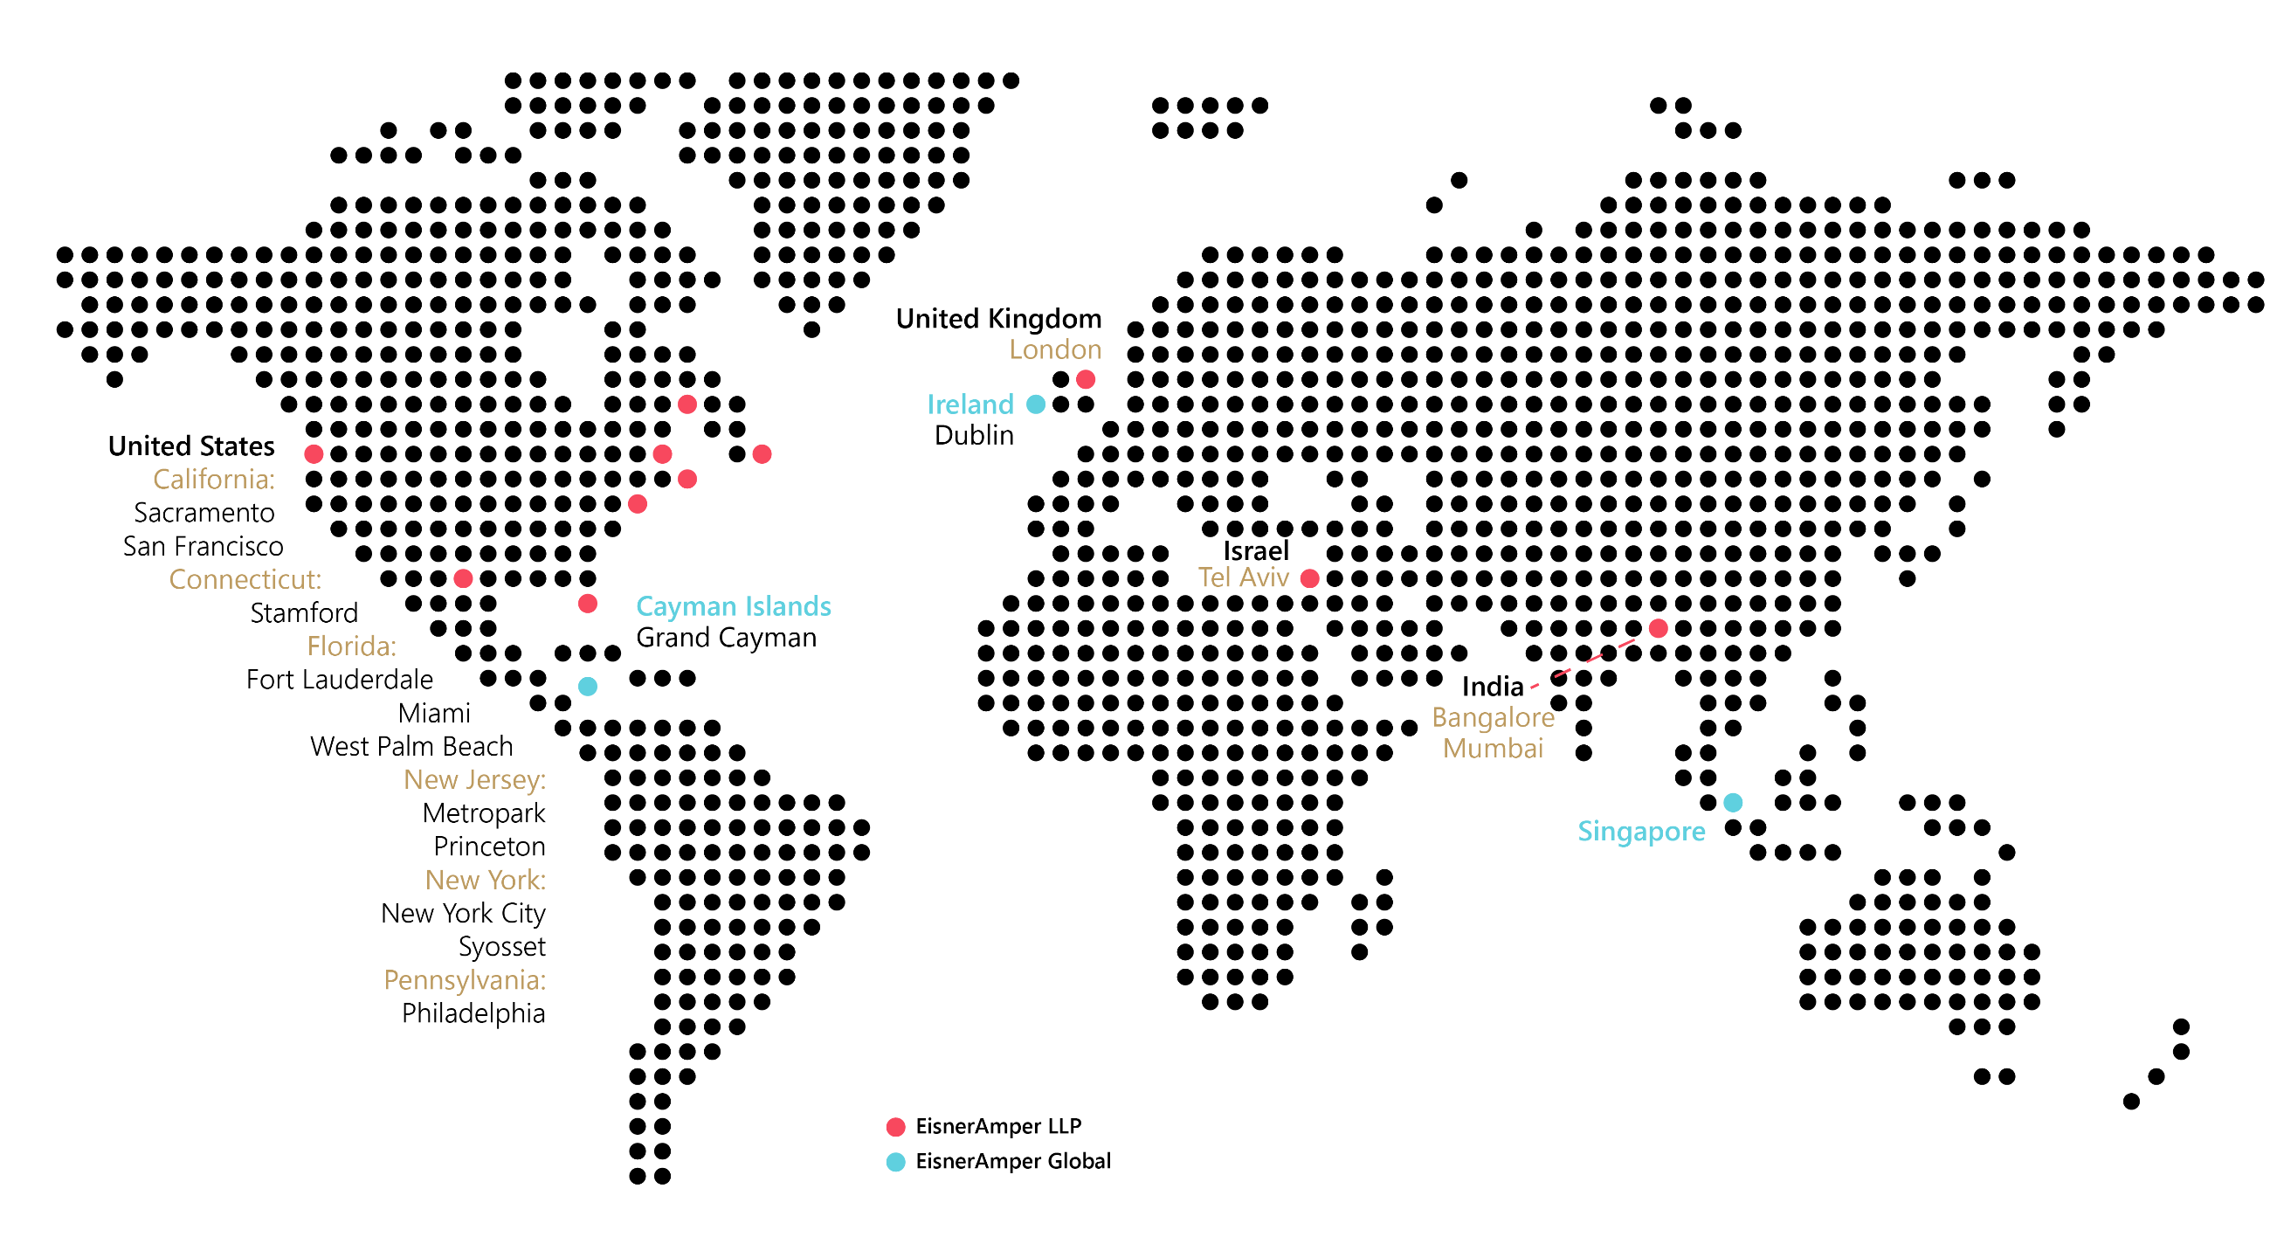
EisnerAmper’s Global Reach

Slide 5
Service & Ability
Accounting & Audit
Audit & Assurance
Employee Benefit Plan Audits
Internal Audit
Outsourced Finance & Accounting
Royalty Audit/Contract Compliance
Technical Accounting Advisory
Tax
Federal, State, Local, and International Taxation
Accounting for Income Taxes
Merger, Acquisition and Divestiture Services
Net Operating Loss Carryforwards (Sec. 382)
Personal Wealth Advisors
Tax Function Outsourcing
Tax Controversy & Advocacy
Transfer Pricing
Advisory
Benchmarking
Center for Family Business Excellence
Corporate Finance
Disaster Advisory
Employee Benefits Advisory
Federal Government Contracting
Financial Advisory Services
Bankruptcy & Restructuring
Forensic Litigation and Valuation Services
Process, Risk and Technology Solutions
Transaction Advisory

Slide 6
Specialization & Focus
Life Sciences
Manufacturing and Distribution
Private Business Services
Real Estate & Construction
Corporate Finance
High Net Worth Individuals
Financial Services & Portfolio Companies
Not for Profit
Public Sector Advisory
Bankruptcy and Restructuring
Health Care
Litigation
Public Companies
Technology & Life Sciences
Law Firms
Sports & Entertainment
Insurance

Slide 7
Disclaimer
Note: This presentation reflects current guidance from the SBA through June 16, 2020, and changes outlined in the Paycheck Protection Program Flexibility Act signed into law on June 5, 2020. Further changes are expected as the SBA continues to release additional guidance. Please follow closely the EisnerAmper COVID-19 Knowledge Center for further information and guidance.

Slide 8
Paycheck Protection Program Continues to be a Moving Target
SBA and Treasury Department continue to issue “interim final rules” and further guidance through FAQs
18 “interim final rules”
48 pieces of guidance
On Friday June 12th, Senate democrats strongly urged the SBA and Treasury Dept. to streamline the forgiveness process recommending several changes including a simple application for low dollar loans.

Slide 9
Quick Review of PPP Loans (Prior to PPP Flexibility Act Changes)
Maximum loan amount is $10 million per borrower and is based on 2.5x average monthly payroll
Payroll cost = Gross Employee Pay (capped at an annual rate of $100,000 per employee) +State Unemployment Insurance and Employer Paid State Disability Insurance +Employer Benefit Costs + Employer Retirement Costs
PPP loans were to be used to cover 8 weeks of:
Payroll – salary, wages, vacation, parental, family, medical, or sick leave and employer paid health and retirement benefits
2019 self-employment income for sole proprietors, independent contractors and active general partners capped at an annual rate of $100,000 per person
Real and personal property rent – lease in effect before 2/15/2020
Real and personal property mortgage (INTEREST ONLY) – mortgage was executed before 2/15/2020
Utilities – service had to begin before 2/15/2020
Utilities include water, gas, electric, telephone (cell and landline), internet and transportation
PPP loans are fully or partially forgivable if funds are spent according to specified criteria. At least 75% of the forgiven amount must be attributable to payroll costs.
Eligible expenses must be paid during the covered period or incurred during the covered period and paid by the next regular payroll or billing cycle payment date
Forgiveness amount will be cut back if a borrower has reduced FTE headcount or individual salaries in the covered period compared to an earlier reference period. These cutbacks can be eliminated through the use of safe harbor provisions included in the CARES Act.
The portion of any loan not forgiven is repayable with interest at 1% per annum over a 2-year period with payments beginning 6 months after the loan disbursement date
As of June 9, 4.5 million loans totaling $511 billion had been guaranteed by the SBA and $130 billion of funding was available through June 30

Slide 10
PPP Loan Scrutiny
Borrower must certify in good faith that uncertain economic conditions due to COVID-19 make the loan necessary to support ongoing operations
Later Treasury guidance suggested that borrower’s assessment of need should include consideration of their current business activity and their ability to access other sources of liquidity
This later Treasury guidance applied to all applicants regardless of phase of application
No questions asked for borrowers that applied for PPP loans prior to April 23 and repaid the loan by May 18
Public companies and VC/PE backed companies strongly encouraged to repay PPP loans
Treasury announced on May 13 that recipients of PPP loans less than $2 million will be deemed to have made the required certification concerning the necessity of the loan request in good faith. Recipients of more than $2 million will not face administrative enforcement or referrals to other agencies if the borrower promptly repays the loan upon notice from the SBA that it did not have an adequate basis for making the good faith certification.

Slide 11
Factors Reducing Forgivable Amounts
Using PPP funds on the right expenses is easy to understand. Complications occur when your headcount and pay levels change from the base period.
Headcount Reduction
Simple example:
5 FTEs earning $3,000 per month in 2019
PPP loan amount =$37,500
Headcount reduced by 2 FTEs during the covered period
Forgivable amount = $37,500 *( 3/5)= $22,500
Pay Reduction
5 FTEs each earning $3,000 per month in 2019 and in the covered period
PPP loan amount = $37,500
Reduce salaries to $2,000 per month each
75% of 2019 salary= $2,250
8 week eligibility period
Forgiveness reduction = (250*5*12)* (8/52)= $2,308
Forgivable amount = $37,500 – $2,308 = $35,192

Slide 12
Safe Harbors for Restoration of FTE or Salary Reductions by June 30
Borrowers are exempted from reductions in forgiveness resulting from headcount or pay reductions if they reduced FTE levels or salary/wage levels in the period between February 15 and April 26, 2020 and fully restored those levels by June 30 to the February 15 amounts.
Headcount Reduction Safe Harbor
Simple Example:
5 FTEs as of February 15
Headcount reduced by 2 FTEs between February 15 and April 26
2 or more FTEs hired (or re-hired) by June 30 – no reduction in forgiveness due to headcount regardless of the calculations on the prior slide
1.9 or fewer FTEs hired (or re-hired) by June 30 – safe harbor does not apply
Headcount not reduced between February 15 and April 26
Safe harbor does not apply
Salary/Wage Reduction Safe Harbor
Simple Example:
Employee A earned an annual salary of $36,000 as of February 15
Annual salary reduced to $24,000 on March 21 (halfway point) so average annual salary from February 15 to April 26 was $30,000
Annual salary restored to $36,000 or more by June 30 – no reduction in forgiveness due to salary reductions regardless of the calculations on the prior slide
Annual salary restored to $35,999 or less by June 30 – safe harbor does not apply
Annual salary not reduced between February 15 and April 26
Safe harbor does not apply

Slide 13
Exemptions on Rehiring Employees
Employees furloughed or laid off after 2/15/2020 may reject your re-employment offer for any number of reasons.
You are allowed to exclude these employees when determining reductions to forgiveness if:
A written offer to rehire was made in good faith
Offer to rehire was at the same salary and number of hours as before
Employee’s rejection of the offer is documented
The state unemployment office is notified within 30 days
Other conditions may also qualify for an exemption:
Employee fired for cause
Employee voluntarily resigned
Employee requested and received a reduction of their hours
Additional safe harbors have been established under the PPPFA for:
Inability to hire similarly qualified employees
Safety requirements prohibited return to normal operations

Slide 14
Forgiveness for Self-Employed Individuals or Independent Contractors
Owner compensation paid during the covered period limited to the lesser of 8/52 of self-employment income as determined by Schedule C net profit from your 2019 tax return or $100,000, but not less than zero
Mortgage interest, rent and utilities expenses must have been claimed on your 2019 Form 1040 Schedule C to be eligible for forgiveness if paid during the covered period
Retirement and medical benefit payments for the benefit of self-employed individuals are included in the cap

Slide 15
Forgiveness for Partnerships
Active general partners are eligible for forgiveness for the same amount claimed for partner compensation when you applied for PPP loan (on a prorated basis)
Maximum compensation per partner is capped at 2019 Schedule K-1 net earnings from self employment, minus certain deductions, multiplied by 0.9235, capped at $100,000, but not less than zero
Rent, utilities and mortgage interest if they are eligible to be deducted on a business tax return
Retirement and medical benefit payments for the benefit of partners are included in the cap

Slide 16
PPP Loan Changes – June 5 – PPP Flexibility Act (1/2)
Many recipients of PPP loans were having a difficult time spending the funds over the original 8 week covered period due to current economic conditions. Therefore, under the PPP Flexibility Act signed into law on June 5:
Eligible expenses may now be incurred over a 24 week period, starting with the day that the lender made the money available, but no later than December 31, 2020
At least 60% of the loan has to be used for payroll costs and no more than 40% can be used for non-payroll costs
Safe harbor date for purposes of eliminating cutbacks to forgiveness amount based on reductions in headcount or individual salaries is extended from June 30 to December 31, 2020
New safe harbor for documented inability to rehire individuals employed on February 15, 2020 or inability to hire similarly qualified employees for unfilled positions before December 31, 2020

Slide 17
PPP Loan Changes – June 5 – PPP Flexibility Act (2/2)
New safe harbor for documented inability to return to February 15, 2020 level of business activity before December 31, 2020 due to compliance with requirements established by federal agencies
Borrowers that received their loans before the PPP Flexibility Act may choose to end the covered period 8 weeks after the origination date
Maturity of PPP loans issued on or after June 5 extended to 5 years. Interest rate remains at 1%. Borrowers and lenders may renegotiate existing loans to a similar maturity.
The payment of principal and interest on the PPP loan is now deferred until the day that the forgiven amount is remitted to the lender (approximately 5 months after the forgiveness application is submitted to the lender, unless the borrower appeals an SBA denial of forgiveness) or 10 months after the end of the borrower’s covered period, whichever is earlier
PPP borrowers who receive any loan forgiveness are now also eligible for continued employer payroll tax deferral under the CARES Act

Slide 18
Applying for Loan Forgiveness
Applications for loan forgiveness will be processed by the lender that originated your loan
PPP Forgiveness Application Form must be completed and submitted to your lender
Lender is required by law to confirm calculations and review backup for certain amounts on the application form and provide a decision on forgiveness to the SBA within 60 days of receiving the completed application. SBA has 90 days thereafter to review the decision.
Documents required for lender review of forgiveness amount
Payroll reports from payroll provider
Payroll tax filings
Income, payroll and state unemployment insurance filings
Source documents for retirement and health insurance contributions
Cancelled checks, payment receipts or account statements for eligible interest, rent and utility payments

Slide 19
Other Considerations
Loan forgiveness will not be included in taxable income and deductions will not be allowed for forgiven expenses under a recent IRS notice
Supporting documents for PPP loan forgiveness must be retained by the borrower for 6 years after loan is forgiven or repaid and are subject to SBA review during that period
Prepayments of interest are not an allowed use of PPP funds and not eligible for forgiveness. Language is unclear about prepayments of other categories of eligible expenses
Employee hazard pay, bonuses or commissions paid during the covered period are eligible for forgiveness, subject to the $100,000 per employee cap

Slide 20
Questions?

Slide 21
Thank You
Alan Wink
Craig Rothman
Jon Zefi
Managing Director
Audit Partner
Principal
EisnerAmper LLP
EisnerAmper LLP
EisnerAmper LLP
Alan.Wink@eisneramper.com
Craig.Rothman@eisneramper.com
Jon.Zefi@eisneramper.com

Slide 22
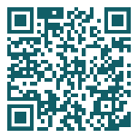
EisnerAmper’s COVID-19 Resources
We’re here to help. Many questions have come in about government assistance programs, SBA loans, liquidity, remote technology, business continuity, etc.
COVID-19
Visit our Coronavirus Knowledge Center
EisnerAmper.com/coronavirus
Direct questions to our Coronavirus Response Team
ResponseTeam
@EisnerAmper.com
Clients:
kindly send your work & documents
digitally through the Client Portal

