Slide 1
Welcome!
ESI is HERE for you during this crisis.
Notes:
These are unprecedented times. How can we care or ourselves and each other?

Slide 2
A conversation about…
Mental Health and COVID-19
Notes:
These are unprecedented times.
Thank you for being here with us today.
How can we care or ourselves and each other?
Talking about challenging issues.
People have different relationships with these issues so I’m going to ask you to mute both voice and video so everyone has a degree of privacy as they engage with this presentation..
Practice SELF CARE today – step away if you need – ask a questions…
Within social distancing guidelines

Slide 3
Topics for Today
Self Care is Paramount
Think Differently About Mental Health
How Can We Help?
Resources
Prevalence of Mental Health Problems (US and Law)
Notes:
We have to take care of ourselves.
Reducing the stigma and the way we think and talk about MH
How can we recognize mental health problems developing and
How can we assist both in general and three particular crises that might appear during this time.
Look at local and national tele-resources.

Slide 4
Isolation from each other takes a toll.
Notes:
We have been isolated for at least 2 weeks now, with no end in sight.
At first it was novel – now it is wearing.
Many studies show that social isolation increases the likelihood for health issues, like heart disease and stroke and even increases the rate of early death by as much as 29%
Those are looking at issue over long term and we believe this current situation is finite.
However, we have to think about the trauma that it may cause even after this crisis dissipates. We are getting out of the habit of socializing – of touching and hugging – of connecting emotionally and just because we are suddenly allowed to again doesn’t mean we will – unless we take steps to mitigate the trauma now.
So – what can we do to help keep ourselves and one another as mentally healthy as possible during this time, so that we can rebound well.
We should be aware that stress and change can cause increase in anxiety and depression – 2 of the most common mental health diagnoses in the US.

Slide 5
Anxiety and Depression are already Prevalent
They can occur even without a diagnosed illness.
Notes:
Almost 20% of americans have diagnosed anxiety and/or depression.
Uncertainty in anything can increase this. We are very uncertain right now. Financially, Socially, employment homes…school…etc.
In some ways people without diagnoses could be at an elevated risk. Those with a diagnosis already have some tools to use to help them cope.
Mental health problems – a set of symptoms causing distress that may not yet have risen to the level of a diagnosable illness.
SO – who do we think of FIRST? CHAT?

Slide 6
Type of Mental Disorder | % US Adults | In LAW
Anxiety disorder | 18.1 .
Major depressive disorder | 6.8 .
Substance use disorder | 8.1
Bipolar disorder | 2.8 .
Eating disorders | 5-10 .
Schizophrenia | 0.3 – 0.7 .
Any mental disorder | 18.5 .
Courtesy of Mental Health First Aid USA
Notes:
One in 5 adults in US has a mental health issue at any given moment.
The Prevalence of Substance Use and Other Mental Health Concerns Among American Attorneys – JAMA, 2016
ABA in conjunction with Hazelden Betty Ford Clinic
12,825 attorneys
Well-established tests proven to yield reliable results
Alcohol
Drug Use
Mental Health

Slide 7
Type of Mental Disorder | % US Adults | In LAW
Anxiety disorder | 18.1 . | 61.1
Major depressive disorder | 6.8 .
Substance use disorder | 8.1
Bipolar disorder | 2.8 .
Eating disorders | 5-10 .
Schizophrenia | 0.3 – 0.7 .
Any mental disorder | 18.5 .
Courtesy of Mental Health First Aid USA
Notes:
One in 5 adults in US has a mental health issue at any given moment.
The Prevalence of Substance Use and Other Mental Health Concerns Among American Attorneys – JAMA, 2016
ABA in conjunction with Hazelden Betty Ford Clinic
12,825 attorneys
Well-established tests proven to yield reliable results
Alcohol
Drug Use
Mental Health

Slide 8
Type of Mental Disorder | % US Adults | In LAW
Anxiety disorder | 18.1 . | 61.1
Major depressive disorder | 6.8 . | 45.7
Substance use disorder | 8.1
Bipolar disorder | 2.8 .
Eating disorders | 5-10 .
Schizophrenia | 0.3 – 0.7 .
Any mental disorder | 18.5 .
Courtesy of Mental Health First Aid USA
Notes:
One in 5 adults in US has a mental health issue at any given moment.
The Prevalence of Substance Use and Other Mental Health Concerns Among American Attorneys – JAMA, 2016
ABA in conjunction with Hazelden Betty Ford Clinic
12,825 attorneys
Well-established tests proven to yield reliable results
Alcohol
Drug Use
Mental Health

Slide 9
Type of Mental Disorder | % US Adults | In LAW
Anxiety disorder | 18.1 . | 61.1
Major depressive disorder | 6.8 . | 45.7
Substance use disorder | 8.1 | 20.6 A; 21.6 O
Bipolar disorder | 2.8 .
Eating disorders | 5-10 .
Schizophrenia | 0.3 – 0.7 .
Any mental disorder | 18.5 .
Courtesy of Mental Health First Aid USA
Notes:
Before we move on – WHO do you think will need the most care?

Slide 10
Mental Health Issues
Anxiety: 61.1% - women more than men
Depression: 45.7% - men more than women
Social Anxiety: 16.1%
Panic Disorder: 8%
Bipolar Disorder: 2.4%
Note how much more prevalent top 2 are than in US adults overall.
Notes:
The Prevalence of Substance Use and Other Mental Health Concerns Among American Attorneys – JAMA, 2016
ABA in conjunction with Hazelden Betty Ford Clinic
12,825 attorneys
Well-established tests proven to yield reliable results
Alcohol
Drug Use
Mental Health

Slide 11
Alcohol Use
20.6% Problematic drinking (6.1% of general population)
Men more than Women
MEN: 25.1%
Women: 15.5%
Young more than Older
30 or Younger: 31.9%
51-60: 16.2%
Employment Matters
Bar Association Employed: 24%
Solo Practitioner: 19%

Slide 12
Drug Use – Illicit or Licit
74.1% used stimulants
51.3% used sedatives
46.8 % used tobacco
31% used marijuana
21.6% used opioids
Notes:
tobacco – 21% some tobacco us in all US Adults in past month
– 13.3% of gen pop

Slide 13
You can’t pour from an empty cup.
Notes:
Who is the most important person in the rescue? YOU ARE
INTERACTION -
What kinds of things are you doing to take care of yourself?

Slide 14
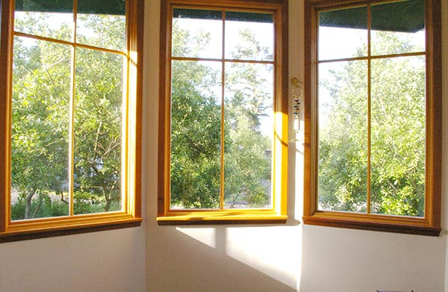
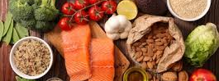
Take care of your
BODY
Notes:
Take care of your body
Eat healthy
Exercise
Get sunlight if you can (even a light lamp)
Look to replace the oxytocin that occurs from hugging and touching

Slide 15
Take care of your
MIND
Notes:
Take care of your mind – use relaxation techniques/distractions
Listen to Music
Read a Book
Practice Yoga

Slide 16
Notes:
Find mindfulness APPS
Maybe most importantly…

Slide 17
Limit your consumption of the news!
Notes:
It is important to remember though, that we are…

Slide 18
We are
in this
ALL
TOGETHER
Notes:
Gov Cuomo said in a recent press conference that we must be “Socially distant and Spiritually connected” YES.
How can we assist our family, friends, and neighbors – whether we are in their proximity or not?-
First – be mindful of how we think and talk about mental illness.

Slide 19
Words Matter
Bats
CRAZY
Insane
Nutty as a fruitcake
wacko
This weather is so BIPOLAR
Nuts
Lunatic
You’re so OCD
wacko
Moron
nutcase
Retarded
This whatever is making me NUTS
SCHIZOID
Flake
Psycho
Don’t be so Schizo
Hysterical
Notes:
INTERACTION - what are phrases or words you have heard or do you find yourself using that maybe you could change? Mine is “this is driving me NUTS/CRAZY’ another is bullet points.
GREAT –

Slide 20
How can we help others?
Know the resources in your area
Talk Privately
Be upfront and direct with your concerns
Listen non-judgmentally to their concerns
Stay centered on the other person’s concerns.
Keep conversation open for the future.
Know your own limits.
Self care
Notes:
When we see someone that we are concerned about –
maybe their temper is short –
maybe they don’t seem to want to get out of bed –
maybe they aren’t taking care of themselves –or their emotions are high –
or they are using drugs or alcohol ina way that makes you worry
Use these general concepts

Slide 21
Say THIS . . . Not THAT
I’m worried about you. Can we talk about what you are feeling?
How can I help?
It is ok to feel whatever you are feeling.
I can’t understand exactly how you are feeling, but I can listen and find help.
Cheer up! You’ll feel better tomorrow.
You seem ok to me!
I know just how you feel! I was depressed for a couple of days last week.
Stop focusing on the bad stuff!
Notes:
Again – thinking about how we use words – some ideas might be…
Those on the Right shut the door
Those on the left keep the door open

Slide 22
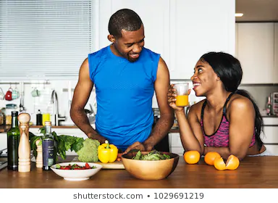
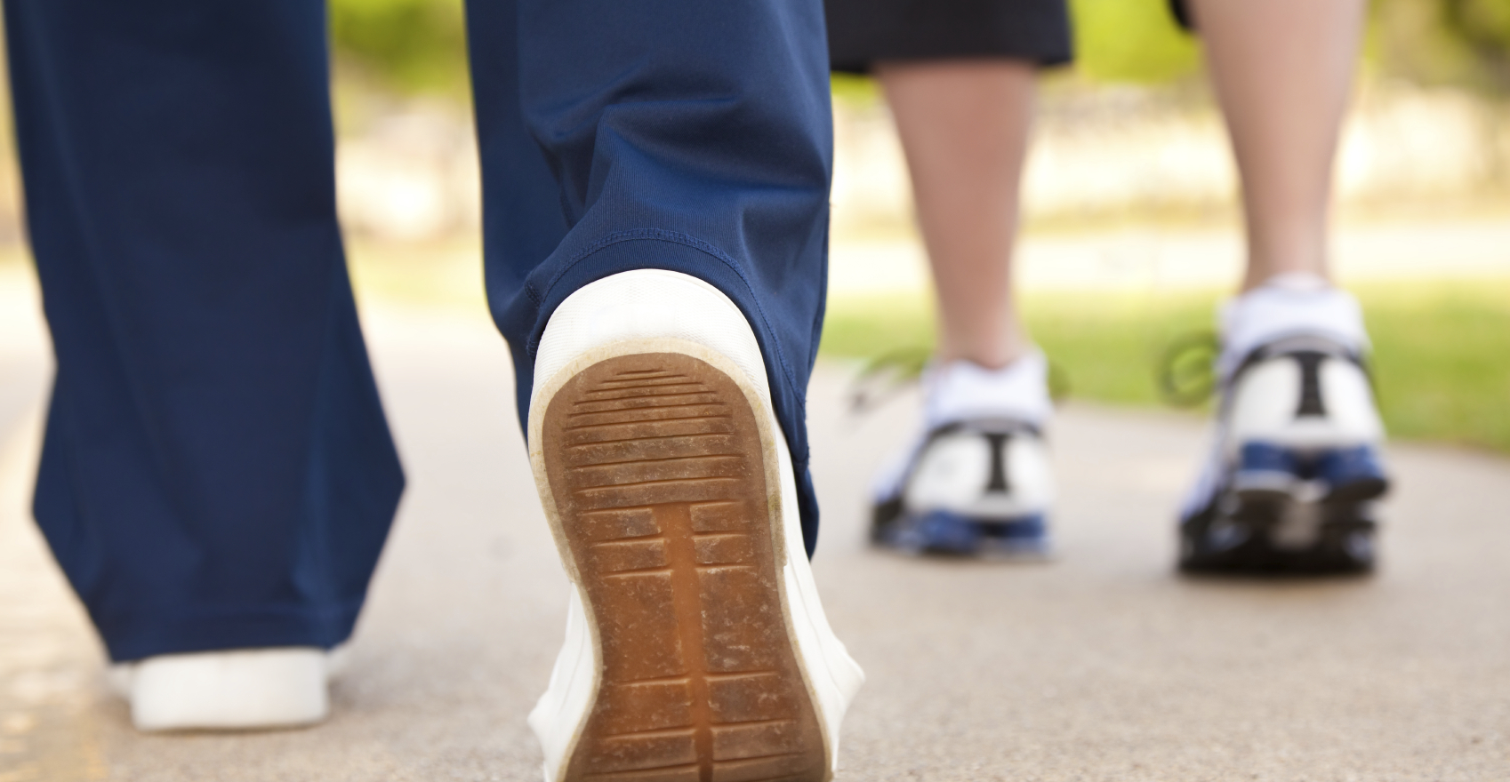
Encourage Others to Take Care of themselves, too.
Notes:
Take care of your body
Eat well
Exercise
Practice Relaxation Therapy
Let Sunshine into your space if you can
Be compassionate to yourself
WORK TOGETHER

Slide 23
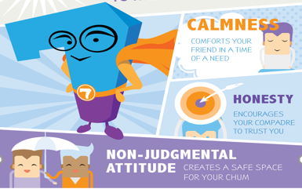
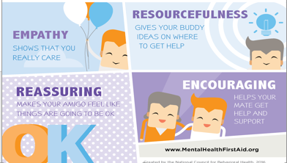
Seven SUPER Skills to help a friend…

Slide 24
Encourage Others in the same way you care for yourself.
Eat well
Exercise
Practice Relaxation Therapy
Let Sunshine into your space if you can
Be compassionate to yourself
Stay connected through FaceTime, Google, or phone calls
Be mindful about media consumption

Slide 25
Notes:
BEFORE we go to specific topics, I want to check in with Rebekah to see if there are questions. Chat your specific questions.

Slide 26
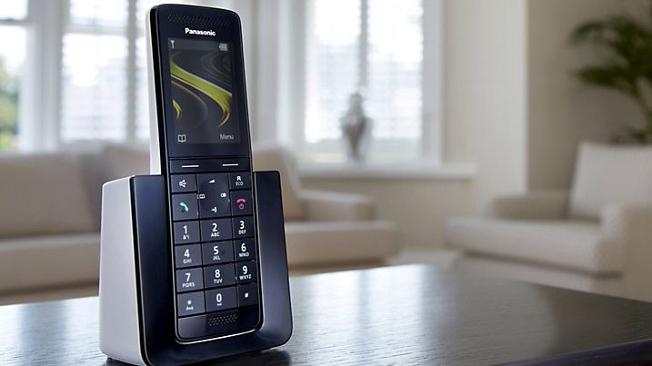
Notes:
Remember – adding techno stress to older folks is not necessary. Sometimes a phone call is fine.

Slide 27
Sometimes, despite our best efforts, crises can occur.
Panic attack
Violence
Suicidal thoughts and behaviors

Slide 28
A PANIC ATTACK is the abrupt onset of intense fear or discomfort that reaches a peak within minutes and includes at least four of the following symptoms: Palpitations, pounding heart, or accelerated heart rate. Sweating. Trembling or shaking. Sensations of shortness of breath or smothering.

Slide 29
All first aid for PANIC ATTACK must be appropriate for HEART ATTACK.
Remain Calm.
Speak slowly and clearly.
Be PATIENT.
Acknowledge that FEAR feels REAL.
Remind them they aren’t going to die.
Remind them they are SAFE.

Slide 30
Violent tendencies can be exacerbated by stress and uncertainty – the very things that are dominating our lives during this crisis. Interpersonal Violence and Domestic Violence are both of concern
Notes:
Stress doesn’t make a non violent person violent but can make a violent person more likely to use violence.
Interpersonal violence – between acquaintances or strangers
Domestic violence (also called intimate partner violence (IPV), domestic abuse or relationship abuse) is a pattern of behaviors used by one partner to maintain power and control over another partner in an intimate relationship.

Slide 31
Interpersonal Violence? – Extract yourself from the situation, if possible, AND
Call 911
Domestic Violence?
If you overhear neighbors in a potentially dangerous situation – call the police
Immediate danger? 911
If you have concerns but don’t think there is imminent danger, call 311 and ask for a wellness check.
Call the National Hotline for ideas on how to help your friend or neighbor.
Home isn’t always safe. nyc.gov/nychope

Slide 32
SUICIDAL IDEATION means someone is having recurrent thoughts about death or being dead. They may write about death or be actively planning to take their own life by devising a plan and gathering means.

Slide 33
If you think someone may be thinking of suicide…
ASK THE QUESTION
Then ask if they have a plan.

Slide 34
How to help someone who may be actively suicidal
Let the person know you are concerned and WILLING to help
Do not express negative judgement
Try to appear confident
Provide a safety contact number
Don’t leave them alone
Avoid using guilt or threats as a means to cease the feelings
Don’t agree to keep their plan – if they disclose it – a secret

Slide 35
Resources
Local Resources
NYC Well (A 24/7 Confidential hotline staffed with trained counselors which can provide services in over 200 languages.)
Call 888-NYC-WELL (888-692-9355)
Text “WELL” to 65173
Chat at NYC.gov/nycwell
OMH Emotional Support Line: 1-844-863-9314
NYC’s 24 hour Domestic Violence Hotline 800-621-4673 or nyc.gov/nychope
National Resources
American Psychiatric Association Answer Center 1-888-357-7924
Substance Abuse and Mental Health Services Administration’s (SAMHSA) Disaster Distress Helpline at 800-985-5990
National Suicide Prevention Hotline: 1-800-273-8255
Spanish callers: 1-888-628-9454
Text MHFA to 741741 to talk to a Crisis Text Line counselor.
Notes:
QUESTIONS – chat to Rebekah

Slide 36
Mental Health Matters!
Thank you for CARING enough to be here today!

Slide 37
Microshield CPR Mask
Pocket CPR Mask
Wallet First Aid Kit
HOME AED
Pads and Batteries
Wall Cabinet
AED Signage
Fast Response Kit
HOME AED and Accessories AVAILABLE NOW

Slide 38
Training Options
VIRTUAL CPR AED CERTIFICATION
Traditional CPR Course in your own HOME
Manikin and training equipment shipped to you.
Connect via web-conference with other students and an instructor
CPR AED BLENDED LEARNING CERTIFICATION
Same content as traditional course
Part 1: Self-directed online learning program
Part 2: Skills practice and testing done one-on-one with an instructor when we can gather in small groups - OR virtually now.
Mental Health First Aid Certification Course
8 HR training teaching participants to identify, understand and respond to signs of mental illnesses and substance use disorders.
May be done in 1 8HR session; 2 4HR sessions; 4 2HR sessions
Virtual Blended coming SOON

Slide 39
Contact Us!
On the WEB: www.emergencyskills.com
By phone: 212-564-6833
On Instagram: emergencyskills
Sarah Gillen sarahg@emergencyskills.com
Barbara Kinter Barbara@emergencyskills.com

