Slide 1
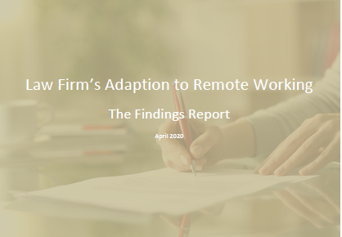
Leading Remotely

Slide 2
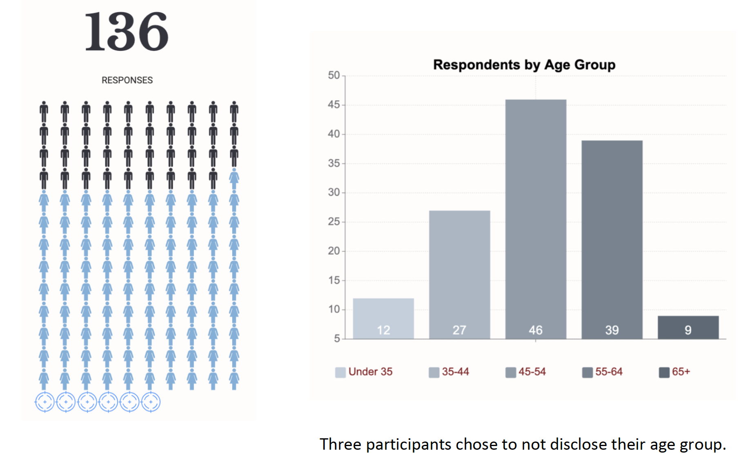
Survey Stats

Slide 3
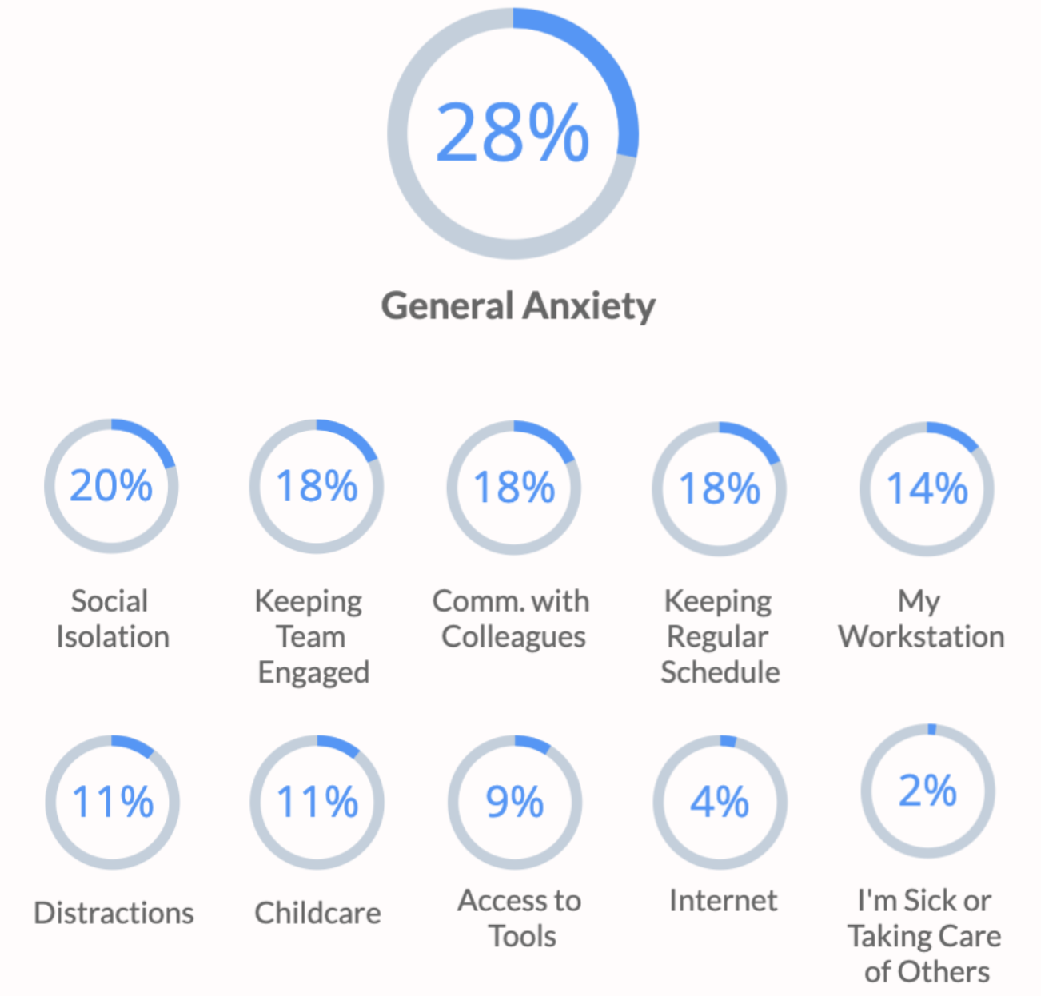
Biggest Challenges with Working Remotely
Not surprisingly, people are struggling with the health and financial uncertainties related to the epidemic.
That, combined with fears of social isolation and communication challenges, can lead to potentially harmful mental
health consequences, which can impede one’s ability to reduce stress, stay focused and collaborate.
Notes:
As leaders what does this mean to us?
We can’t ignore the emotional reactions from our team members…and ourselves. We have to strive to practice healthy mental and physical practices….now more than ever. And encourage our staff to do so too. Pull out the Mind Body Soul work done under Jenniffer’s leadership. Go to our digital catalog and take the free “How to maintain Balance during the Coronavirus course”. Ask your team to do it and discuss it at a team meeting.

Slide 4
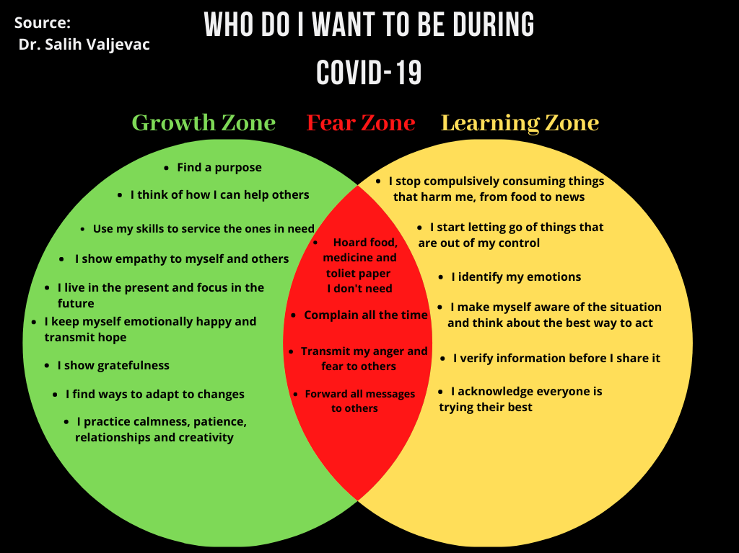

Slide 6
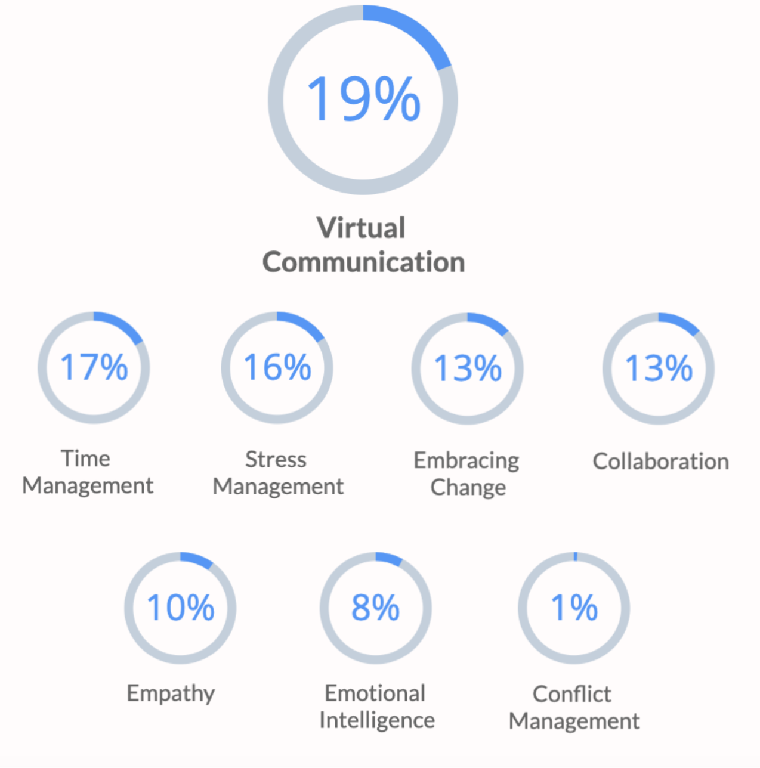
Most Urgent Soft Skills
Conflict Management usually ranks near the top of needed soft skills training, so its low
ranking here suggests that, at this moment, people are focused on improving the most appropriate skills for dealing
with the crisis: communicating in a virtual environment, managing time, reducing stress, embracing change, and
collaboration.
Notes:
We have to think about how we are communicating as leaders. We are in a new world, requiring us to prioritize communication in a new way. It has ALWAYS been important, but now more than ever.
Can one overcommunicate? What does too much communication look like? And what are the consequences?
How about too little communication…what are the consequences?

Slide 7
Notes:
Tips for leaders…straight from our own learning…and our team.
What would you add?

Slide 8
More Resources at development.loebleadership.com

Slide 9
Questions?
20-40 hours of pro bono coaching available right now
Email Natalie at natalie@loebleadership.com
Notes:
20-40 hours of pro bono coaching

Slide 10
Thank you for having us!
Stay well! We’ll ride this out together!

