Slide 1
Welcome!
ESI is HERE for you during this crisis.

Slide 2
Your Presenters
Barbara Kinter
Sarah Gillen

Slide 3
A conversation about…
First Aid in the Home

Slide 4
What if I think I may have COVID 19?
If you are sick, STAY HOME
Not better in 3 -4 days? Cal your healthcare provider. (Call, text, telemedicine)
Do NOT go to the ER is you are not severely ill.
Call 311 for help getting medical care
When can I leave if I feel better?
7+ days since symptoms started
Fever free 3+ days WITHOUT the help of fever-reducing drugs
Cough and sore throat symptoms resolved

Slide 5
Agenda
When we can Help
When we need Help
General Concepts

Slide 6
Good Numbers to Have
Poison Control 800-222-1222 or 212- POISONS
Firehouse
Private Ambulance
Police Station
Your local healthcare provider
COVID Hotlines

Slide 7
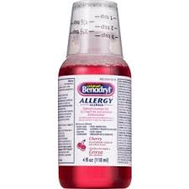
Some Good Things to Have Around the House

Slide 8
Treat all bodily fluids as if they were contaminated
Mask
Gloves
Remove mask and gloves safely
Universal Precautions

Slide 10
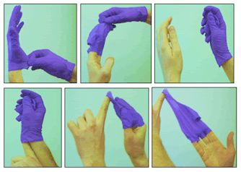

Slide 11
You can DO it!

Slide 12
Remember – you are not expected to be a DOCTOR

Slide 13
ACCIDENTS
Are the most common cause of death in children!

Slide 14
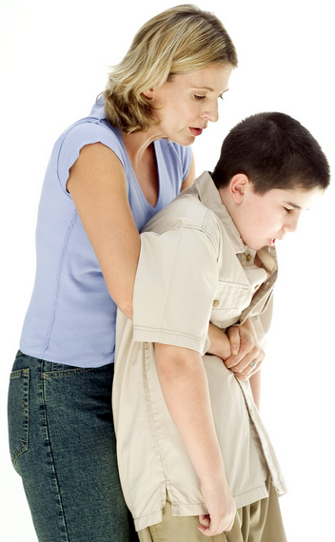
Two Hands
–
Upward thrusts
Hip to Hip

Slide 15
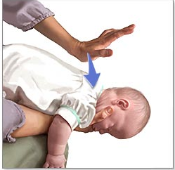

Slide 17
Minor Wound
Wash with antibacterial soap
Apply antibacterial ointment
Keep covered

Slide 18
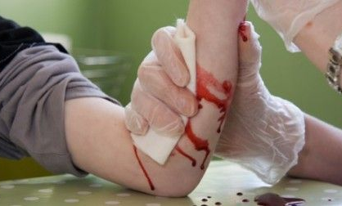
Direct Pressure Pressure Bandage

Slide 20
Direct Pressure Pressure Bandage

Slide 21
FIRST AID for Burns?
Remove the agent of the burn

Slide 22
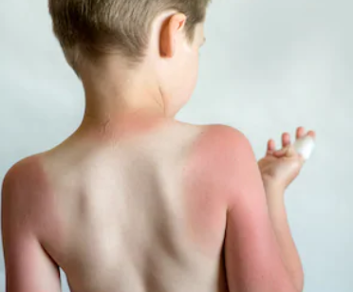
Partial Thickness 1st degree
RED! Painful!
Refer to page 38

Slide 23
Running Water Cool Compress
Refer to page 38

Slide 24
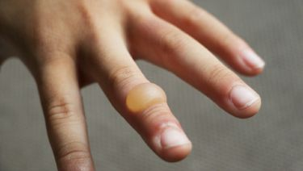
Partial Thickness 2nd degree
RED! Painful!
BLISTERS! Swelling!
Refer to page 38

Slide 25
Submerge in Water Cool Compresses
Refer to page 38

Slide 27
Medical Emergencies

Slide 28
Diabetes …
…a disease in which the body does not produce or properly use insulin

Slide 29
1 or 2?
Type 1
Usually Kids
Little or No Insulin
Insulin Dependent
Chronic
Type 2
Usually Adults
Insulin Present but Not Processed
Medication and/or Insulin
Can be reversed

Slide 30
And the answer is…

Slide 31
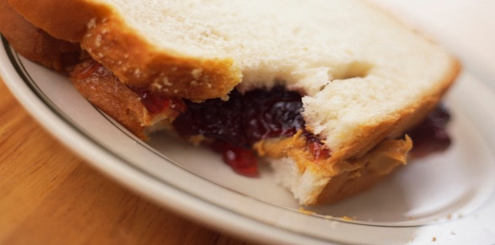
Allergies and Anaphylaxis
Tactile
Inhallation
Ingestion

Slide 32
Allergic Reaction – What will I see?
Tingling/Numbness of Tongue and/or lips
Signs of shock
Severe chest pain/constriction
Difficulty breathing with wheezing
Hives; itching
Swelling of face, tongue, wrists, ankles
Possible convulsions

Slide 33
When Allergies are a Problem…
Tingling/Numbness of Tongue and/or lips
Severe chest pain/constriction
Difficulty breathing with wheezing
Hives; itching
Swelling of face, tongue, wrists, ankles
Possible convulsions

Slide 35
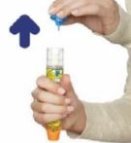
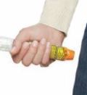
Using an Epi Pen
STEP1
STEP 2
STEP 3

Slide 36
a Seizure…
“…is a brief strong surge of electrical activity (which) affects all or part of the brain”
Refer to page 21

Slide 37
Seizures can be caused by lots of things.
High Fever
Infection
Blow to the head
Diabetic emergency
Dehydration
Medicine or drug overdose
Epilepsy

Slide 38
RECOGNIZE A SEIZURE

Slide 39
RESPOND TO A SEIZURE

Slide 40
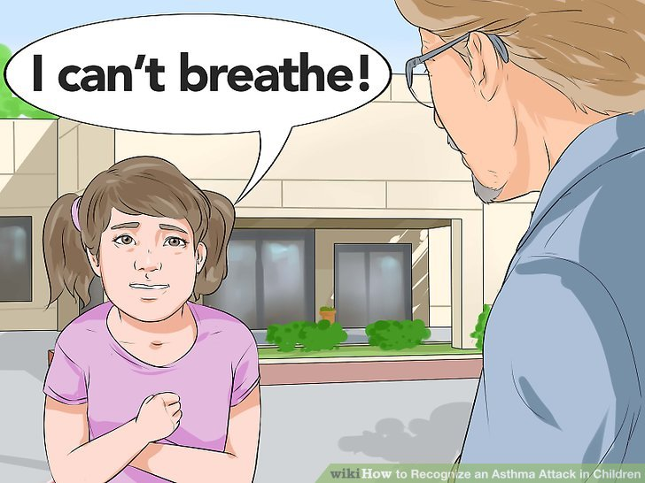
Wheezing
Tight Chest

Slide 41
SIT
Sit Up Straight
CALM
Keep Calm – Redirect
ASK
Ask if they have Inhaler
HELP
Help them take THEIR Medicine
911
Call 911 if symptoms last over 5 minutes

Slide 42
Sometimes you WILL need help.

Slide 43
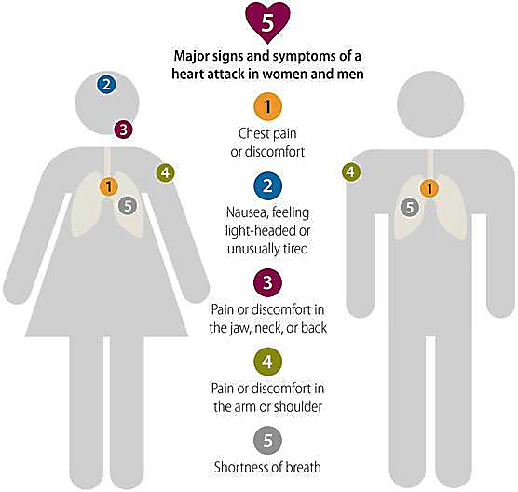

Slide 44
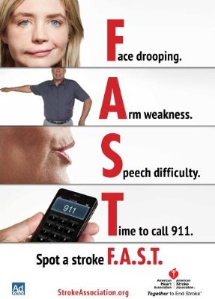

Slide 45
Unresponsive

Slide 48
When SHOULD you call 911?
Is the person unconscious? CALL
Is the person having difficulty breathing? CALL
Can you not make the bleeding stop? CALL
What do I say?
Be specific about your location.
Answer the questions.
Don’t hang up unless you are told to do so.

Slide 49
You CAN make a DIFFERENCE
Thank you for CARING enough to be here today!

Slide 50
Upcoming Virtual Classroom Courses
Tuesday, April 28 3:15 PM
Mental Health and COVID-19

Slide 51
Training Options
REMOTE CPR AED CERTIFICATION
Traditional CPR Course in your own HOME
Manikin and training equipment shipped to you.
Connect via web-conference with other students and an instructor
CPR AED BLENDED LEARNING CERTIFICATION
Same content as traditional course
Part 1: Self-directed online learning program
Part 2: Skills practice and testing done one-on-one with an instructor when we can gather in small groups - OR virtually now.
Mental Health First Aid Certification Course
8 HR training teaching participants to identify, understand and respond to signs of mental illnesses and substance use disorders.
May be done in 1 8HR session; 2 4HR sessions; 4 2HR sessions
Virtual Blended coming SOON

Slide 52
Microshield CPR Mask
Pocket CPR Mask
Wallet First Aid Kit
HOME AED
Pads and Batteries
Wall Cabinet
AED Signage
Fast Response Kit
HOME AED and Accessories AVAILABLE NOW

Slide 53
Contact Us!
On the WEB: www.emergencyskills.com
By phone: 212-564-6833
On Instagram: emergencyskills
Sarah Gillen sarahg@emergencyskills.com
Barbara Kinter Barbara@emergencyskills.com

Slide 54
Contact Us!
On the WEB: www.emergencyskills.com
By phone: 212-564-6833
On Instagram: emergencyskills
Sarah Gillen sarahg@emergencyskills.com
Barbara Kinter Barbara@emergencyskills.com
Beverly Bryant Beverly@emergencyskills.com

