Slide 1
Building Resiliency

Slide 2
Learning Objectives
01
02
03
04
05
Understand the importance of resilience in preventing and managing stress
Identify internal and external factors that support or interfere with resilience
Identify resources to support and build resilience
Having a plan
Dealing with Self Talk

Slide 3
Resilience
The ability to cope with and manage both ordinary and extraordinary life events, and return to one’s usual state of well-being.
Also, the ability to bounce back.

Slide 4
Benefits of Resiliency and Why does it Matter?
WHAT DO YOU THINK?

Slide 5
Characteristics of resilient people
--
Resilient people tend to be
-Purposeful
-Self-reliant
-Accepting
-Optimistic
-Able to re-frame situations
-Less likely to suffer from depression
-Active in taking care of their health

Slide 6
Self-assessment: How resilient are you?
Scale: (1) Never (2) Rarely (3) Sometimes (4) Often (5)Always
I shape my life by the choices I make.
I view change as an opportunity not a problem.
I am comfortable expressing my ideas because others are usually interested in what I have to say
Hard work is more important than luck.
When things go wrong, I remain calm.
6. If I feel overwhelmed, I ask for help.
When I make a mistake, I try to learn my lesson and move on.
I spend most of my time doing things that are worthwhile.
If I am sad or upset, I discuss my feelings with people I trust
If I am angry with someone, I am able to discuss my concerns calmly with that person.

Slide 7
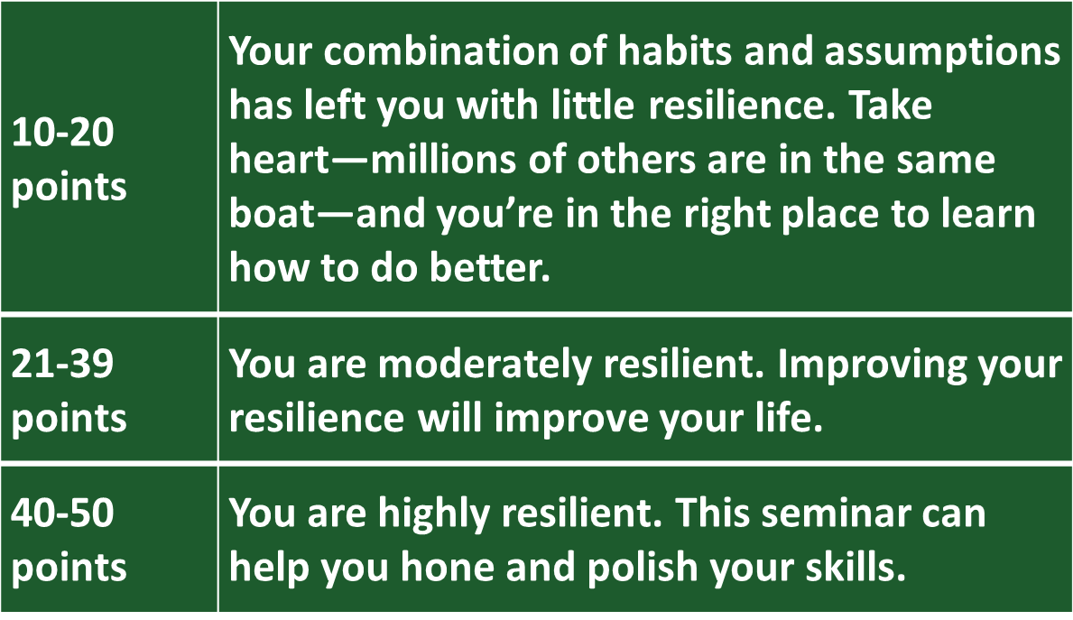
Resilience Levels

Slide 8
What are the sources of Resiliency?
Genetics Culture Beliefs Role models
Problem solving skills Social support Physical health/well-being

Slide 9
Resiliency and Energy Management

Slide 10
Energy Drainers and Boosters
Negative Emotions
Positive Emotions
VENUS
Anger
Frustration
Negative stress
Resentment
Self-pity
Envy
Shame
Joy
Curiosity
Contentment
Amusement
Fulfillment
Gratitude
Calm

Slide 11
Strengthening Strategies
GOAL 1
Goal 2
-Avoid letting negative thoughts take over
-Pay attention to your “self-talk” Use a gratitude journal
-Remember and pursue your passions (hobbies, family, friends, volunteering)
-Review and embrace your past successes
- Learn from your mistakes
-Get connected
-Make every day meaningful
-Learn from experience
-Remain hopeful
-Take care of yourself
-Be proactive
Make every day meaningful

Slide 12
Strengthening Strategies
Avoid letting negative thoughts take over
Pay attention to your “self-talk”
Use a gratitude journal
Remember and pursue your passions (hobbies, family, friends, volunteering)
Review and embrace your past successes
Learn from your mistakes

Slide 13
Reframing: changing how you think about challenges
--
-Change how you interpret and respond to events -Find humor where you can -Avoid dwelling on “worst case” scenarios -Believe there are solutions -Reframing can increase your sense of control and enables you to envision solutions

Slide 14
Changing “self-talk”
Questions to ask yourself about your self-talk or “story”:
-What is real/true about it?
-How can I change it?
-How can I think differently about the people involved?
-What’s positive about this situation?
-What’s the worst-case-possible about this situation and -What does that mean to me?

Slide 15
Take Away’s
Developing resilience takes time and practice!
With guidance, you can improve your resilience and your mental and emotional well-being

Slide 16
What is your plan
What will you do/plan to do for yourself?
Write down 3 things right now

Slide 17
THANKS
Jeffrey Zink
jeffrey@4thbin.com
914-960-1800
Power of Positive Thinking
How to Motivate a Staff
Communications Skills in the Workplace
Conflicts in the Workplace
Leadership Skills

