Slide 1
COVID-19 Financial Impact on the Business of Law
Association of Legal Administrators – NYC Chapter
April 28, 2020
Presentations are intended for educational purposes only and do not replace independent professional judgment. Statements of fact and opinions expressed are those of the participants individually and, unless expressly stated to the contrary, are not the opinion or position of Berdon LLP. Berdon LLP does not endorse or approve, and assumes no responsibility for, the content, accuracy or completeness of the information presented.

Slide 2
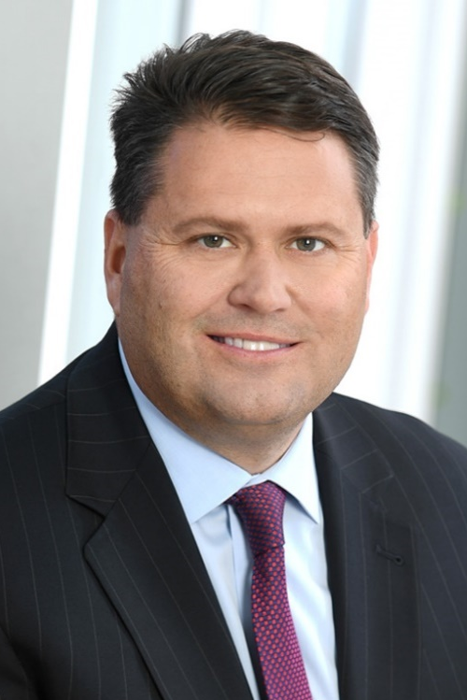
Welcome
John Fitzgerald, Audit Partner, member of the Executive Committee, and Leader of the Law Firm Services Practice at Berdon LLP, has been with the firm since 1991. John is one of Berdon’s key advisors to law practices and also works with closely held businesses in the real estate, hospitality, distribution, and manufacturing sectors. He consults on maximizing opportunities in purchases, sales, and acquisitions; obtaining financing and refinancing; preserving and transferring wealth; and on improving operations.
For law practices, John’s expertise includes; examining the financial and economic impact of partnership agreements; assisting in reviewing candidates for mergers or lateral partner additions; and performing transaction due diligence.
John has authored articles on law firm management issues for ALA Currents, a newsletter of the Association of Legal Administrators; Bloomberg BNA; Legal Management magazine; and Nassau Lawyer.
JFitzgerald@BERDONLLP.com

Slide 3
Areas Covered
Teleworking and staying connected
Business continuity – Identifying savings opportunities and generating cash flow
CARES Act available lines of credit
SBA Paycheck Protection Plan (PPP)
Federal Reserve Main Street Lending Program
Loan forgiveness
Tax Deferral
Nexus

Slide 4
Business Continuity
The main challenge … CASH FLOW
Identifying opportunities for operational savings:
Review nonessential spending
Retreats
Marketing efforts
Conferences, travel
Rent – deferral or abatements
Staffing
Elimination of Associate programs
Defer PTO

Slide 5
Teleworking and Staying Connected
Technology
Cybersecurity
Virtual platforms for conferencing
WFH Productivity

Slide 6
Business Continuity
The main challenge … CASH FLOW
Identifying opportunities for operational savings:
Staffing (continued)
Reduction of partner draws
Looking at additional lines of credit
Existing sources
New sources

Slide 7
CARES Act – Lines of Credit
Paycheck Protection Program
Law Firms are eligible – under 500 employees
Up to $10M of forgivable loan
Proceeds must be used within 8 week period – 75% toward payroll
Main Street Lending Program
Up to 10,000 employees
Low interest loan with deferred payments- no forgiveness

Slide 8
Loan Forgiveness
Recommend creating separate bank account
Maintain contemporaneous documentation
Ensure all uses are properly earmarked (invoice)
Payroll – number of people, payroll registers, 941 reconciliations
Rent payments
Cash disbursements

Slide 9
Loan Forgiveness - FAQ’s
Eligible costs specifics
Utilities
Telephone – does this include mobile devices?
Rent
Do other leases, such equipment leases, qualify under terms of rent?
Health insurance
Is this the employer share only?
Is it only medical premiums or does it include other (LTD, STD)?
What about firm covered furloughed employee share of medical – eligible?

Slide 10
Loan Forgiveness - FAQ’s
Payroll
Compensation over 100k – how is this calculated during the covered period?
Reduction formulas
What is calculation for headcount reduction?

Slide 11
Tax Deferral
The CARES Act allows employers to defer employer FICA through 12/31/2020
The deferred FICA would be paid 50% in December 2021 and 50% in December 2022
Can a firm receive PPP loan funds and defer the FICA?

Slide 12
Nexus
Teleworking requires review of state Nexus
Many states are issuing temporary rulings, but each firm should review and determine if they need to file in additional states
Potential effect on UBT

Slide 13
Questions …
Thank You
John Fitzgerald, CPA
Partner, Law Firm Services Practice Leader
Berdon LLP
(212) 331-7411
JFitzgerald@BERDONLLP.com

